Slide 1


Preliminary Results
for the financial year to 31 March 2025
First Property Group plc
19 June 2025

Slide 2
First Property Group plc
Contents
APPENDIX
Investment Approach
Shareholders >3%
Share Statistics
Plc Management Team
Awards
Disclaimer
Company Description and Structure
Preliminary Results
  Highlights
  NAV
  Dividend
  Outlook
Markets
Investment Markets – Poland
Investment Markets – United Kingdom
  Segmental Analysis
  Fund Management
  Group Properties
    7 directly owned properties
    Associates & Investments
  57-64
  58-59
  60
  61
  62-63
64
65
3-4
  5-16
  6-9
  10-11
  12
  13-14
  15-17
  18-56
  19-28
  29-56
  32-43
  44-56
Notes:
2

Slide 3
First Property Group plc
Company Description
First Property Group plc (AIM: FPO) is an award winning property fund manager and investor with operations in the United Kingdom and Central Europe. Its earnings are derived from:
Fund Management - via its FCA regulated and AIFMD approved subsidiary, First Property Asset Management Ltd (FPAM), which earns fees from investing for third parties in property. FPAM currently manages eleven funds which are invested across the United Kingdom, Poland and Romania.
Group Properties - principal investments by the Group, to earn a return on its own capital, usually in partnership with third parties. Investments include:
  7 directly held properties (6 in Poland, 1 in Romania);
  Non-controlling interests in nine of the eleven funds managed by FPAM (of which c88% by market value is invested in Poland and Romania).
The Company has offices in London and Warsaw.
3

Slide 4

First Property Group plc
Group Structure
Market Capitalisation at 13p per share:
£19m
Fund Management Division (FPAM)
Group Properties Division
11 funds;
18 properties;
Invested across the UK, Poland & Romania
Fee income annualised: £1.19m (EXCLUDING performance fees and the profit share from Fprop Offices LP);
FCA regulated and AIFMD approved (full scope).
7 directly owned properties
6 in Poland, 1 in Romania;
Gross properties at market value: £56.04m;
Gross debt: £24.37m (43% LTV)
Net equity: £31.67m.
Associates and Investments
Non-controlling interests in 9 of the 11 funds managed by FPAM;
Market value: £22.61m.
Cash: £4.82m
Total Net Assets at Market Value: £52.99m
Third party AUM: £164m
4

Slide 5
First Property Group plc
Final Results
Final Results for financial year
ended 31 March 2025
5

Slide 6
First Property Group plc
Highlights
Statutory profit before tax: £3.03 million (31 March 2024: loss before tax of £4.41 million)
Initiated cost savings programme which resulted in annualised cost savings of c.£650,000
Reduction in gross debt by £3.25 million to £24.37 million (31 March 2024: £27.62 million)
Reduction in net debt by £3.44 million to £19.55 million (31 March 2024: £22.99 million)
Cash: £4.82 million (31 March 2024: £4.63 million)
Third party AUM: £164 million (31 March 2024: £222 million)
Total AUM: £220 million (31 March 2024: £274 million)
Weighted average unexpired fund management contract term: 3 year 4 months (31 March 2024: 1 year 9 months)
6

Slide 7
First Property Group plc
Income Statement
Income Statement | Year to 31 March 2025 (unaudited) | Year to 31 March 2024 | Percentage change
Statutory (loss)/profit before tax | £3.03m | (£4.41m) | 168.7%
Diluted earnings per share | 1.64p | (4.04p) | 140.6%
Total dividend per share | - | - | -
Average €/£ exchange rate | 1.1949 | 1.1697 | -
7

Slide 8
First Property Group plc
Financial Position at year end
Statement of Financial Position | 31 March 2025 | 31 March 2024 | Percentage change
Investment properties and Inventories at book value | £46.76m | £45.76m | 2.2%
Investment properties and Inventories at market value | £56.04m | £51.90m | 8.0%
Associates and investments at book value | £21.73m | £19.90m | 9.2%
Associates and investments at market value | £22.60m | £20.26m | 11.5%
Cash balances | £4.82m | £4.63m | 4.1%
Cash per share | 3.26p | 4.18p | -22.0%
8

Slide 9
First Property Group plc
Financial Position at year end
Statement of Financial Position | 31 March 2025 | 31 March 2024 | Percentage change
Gross debt (including deferred consideration) | £24.37m | £27.62m | -6.9%
Net debt | £19.55m | £22.99m | +4.5%
Gearing ratio at book value | 35.1% | 41.5% | -
Gearing ratio at market value | 31.5% | 38.3% | -
Net assets at book value | £45.09m | £38.98m | -10.3%
Net assets at market value | £52.99m | £44.53m | -15.2%
Adjusted net assets per share (EPRA basis) | 35.72p | 39.41p | -16.2%
Period end €/£ rate | 1.1949 | 1.1697 | -
9

Slide 10
First Property Group plc
NAV per share 2007-2024 (excluding any value attributable to FPAM)
NAV per share at book value: 30.50p (31 March 2024: 35.15p)
EPRA NAV per share: 35.72p
(31 March 2024: 39.41p)
Cash per share: 3.26p
(31 March 2024: 4.18p)
External valuers:
CBRE
JLL
Knight Frank
Koterski
Adjusted NAV calculated as per European Public Real Estate Association (EPRA) methodology, which includes fair values of financial instruments; debt; deferred taxes.
NB. NIL VALUE ATTRIBUTED TO FPAM (FUND MANAGEMENT DIVISION, AUM: £164m) IN BALANCE SHEET
10

Slide 11
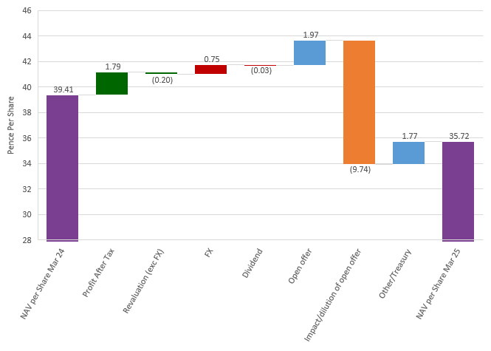
First Property Group plc
Adjusted NAV Bridge
Adjusted NAV breakdown 31 Mar 2025 | NAV breakdown
Associates and Investments | 15.24p | £22.61m
Cash | 3.25p | £4.82m
7 directly owned properties less loans | 17.89p | £26.54m
FPAM | - | -
Other working capital | (0.66p) | (£0.98m)
Total | 35.72p | £52.99m
Adjusted NAV breakdown 31 Mar 2024 | NAV breakdown
Associates and Investments | 17.93p | £20.26m
Cash | 4.09p | £4.63m
7 directly owned properties less loans | 18.07p | £20.42m
FPAM | - | -
Other working capital | (0.68p) | (£0.78m)
Total | 39.41p | £44.53m
11

Slide 12
First Property Group plc
Dividend
Interim dividend:
Nil
(FY 2024: Nil)
Final dividend:
Nil
(FY 2024: Nil)
Total for FY 2025:
Nil
(FY 2024: Nil)
12

Slide 13
First Property Group plc
CEO Comment
Commenting on the results, Ben Habib, Chief Executive of First Property Group, said:
I am pleased to report a material turnaround in the fortunes of the Group.
We appear to be close to the bottom of the cycle, following what has been a severe downturn, especially for office properties.
The economic outlook remains uncertain and it remains a buyer’s market. Even with this uncertain outlook we are seeing interesting deals, some of which we hope to secure.
We are treading cautiously but our fortunes have improved, and we expect this to continue.
13

Slide 14
First Property Group plc
Why invest in Fprop plc?
Expertise:
  Experienced, nimble management team;
  Excellent investment track record: c16% p.a. growth in adjusted net assets, including dividends paid since 2006.
Diversified earnings:
  From Group Properties and from fund management fees;
  From mix of jurisdictions: UK, Poland and Romania = natural hedge.
Growth:
  From letting 3,200 m² of vacant office space in the Group’s directly owned office buildings in Poland (NB. this excludes the property in Gdynia which is now in the hands of administrators);
  From investing Group cash (£4.82m);
  From continued investment of the Fulcrum mandate and from new fund management mandates;
  Operationally geared – can take on new business without material increases in overheads.
Strength:
  Strong balance sheet (net assets £53m, gearing ratio 31% at market value);
  Progressive dividend policy, aligned to the free cash generation of the Group, but subject to it being covered by earnings, targeting a ratio ≥ 2.5x.
14

Slide 15
Markets
15

Slide 16
Investment Markets
Poland
Poland:
GDP is expected to grow by around 3% in 2025 and again in 2026, similar to that of 2024. Interest rates were cut by 50bp in May to 5.25%, the first cut since November 2023, and are expected to be cut to 4.5% by the year end. Inflation is running at similar levels.
Turnover in Poland’s commercial property market in 2024 was around €5 billion, roughly double that recorded in 2023, though still some way below the average of €6 billion per annum recorded in previous years.
The market is still suffering from a withdrawal of capital and a scarcity of banks willing to lend against property.
In general the occupational market is performing better than the investment market, though there still exists pockets of oversupply, such as for offices in Krakow.
16

Slide 17
Investment Markets
United Kingdom
United Kingdom:
GDP forecasts for the UK have been lowered for 2025 to around 1%, similar to that achieved in 2024 (0.9%).
The economic outlook remains highly uncertain. The base interest rate was cut in May by 0.25% to 4.25%, the second cut of the year (cut in February by 0.25%). The market anticipates further cuts to 3.75% by the end of the year.
Inflation remains stubbornly high at above 3% and above the Bank of England’s target level of 2%.
All commercial property delivered a total return in 2024 of 7.7%, including from capital value growth of 1.8%. This was higher than in both 2022 and 2023. Rental values rose by 2.9% in 2024.
Sentiment in the investment market is improving but the market remains bifurcated with large differences in value between well let modern properties which comply with target net zero legislation, and the rest.
17

Slide 18
Segmental Analysis
18

Slide 19
Fund Management
(FPAM)
19

Slide 20
Segmental Analysis: Fund Management
Summary
Fund
Management
Third party AUM: £164m
(31 Mar 2024: £222m);
11 funds invested across UK, Poland & Romania;
Weighted average fund management contract term:
3yr, 4 mths;
Fee income: £1.19m annualised
(31 Mar 2024: £1.83m);
Excellent investment track record;
FCA regulated / AIFMD approved (full scope).
Revenue: £2.26m
(31 Mar 2024: £2.95m);
Contribution to PBT
prior to deduction of unallocated central overheads: £0.65m
(31 Mar 2024: £0.35m).
Decrease in revenue mainly due to:
  A reduction in third party assets under management and a reduction in one off advance payments to £300k (31 Mar 2024 £411k)
20

Slide 21








First Property Group plc
Typical Fund Management Fees / Selection of Clients
Typical fees in UK:
Management: 0.6-1% of GAV p.a.;
Outperformance: 20% of excess returns >IRR equivalent to fund target IRR;
One exception (Fprop Offices LP) – profit share as per below:
  ≤ IRR 7.5% p.a.: 10% of profits up to threshold;
  IRR 7.5%-15% p.a.: 25% of profits in the band;
  ≥ IRR 15% p.a.: 20% of profits above the threshold;
  Payment: annual, equivalent to 10% of total profits (adjusted if necessary for any overpayments made in prior years).
Typical fees in Poland & Romania:
Management: 1% of GAV p.a.;
Outperformance: 20% of excess returns >IRR of 15% p.a.
Selection of clients:
21

Slide 22
Segmental Analysis: Fund Management
Revenue and AUM
Annualised fee income:
£1.19m
(31 Mar 2024: £1.83m)
22

Slide 23
Segmental Analysis: Fund Management
Reconciliation of movement in funds under management
 | Funds managed for third parties (including funds in which the Group is a minority shareholder)
 | UK | CEE | Total | No. of prop’s
 | £m. | £m. | £m.
As at 1 April 2024 | 115.0 | 106.8 | 221.8 | 35
Purchases | 6.4 | - | 6.4 | 2
Property sales | (63.1) | - | (63.1) | (19)
Capital expenditure | 0.2 | 0.4 | 0.6 | -
Property revaluation | (1.8) | 2.6 | 0.8 | -
FX revaluation | - | (2.6) | (2.6) | -
As at 31 March 2025 | 56.7 | 107.2 | 163.9 | 18
23

Slide 24
Segmental Analysis: Fund Management
Third Party funds under management
Fund | Country of Investment | Fund Expiry | Assets Under Management at Market Value at 31 Mar 2025 | No. of Properties | % of Total Third-Party Assets Under Management | Assets Under Management at Market Value at 31 March 2024
 |  |  | £m |  | % | £m
OFFICES | UK | Jun-24 | 27.5 | 1 | 16.8 | 47.4
SIPS | UK | Jan-25 | 3.5 | 1 | 2.1 | 33.8
FGC | Poland | Mar-26 | 23.9 | 1 | 14.5 | 21.7
UK PPP | UK | Jan-27 | 2.6 | 1 | 1.6 | 13.6
SPEC OPPS | UK | Jan-27 | 9.5 | 3 | 5.8 | 12.7
FKR | Poland | Mar-27 | 15.5 | 1 | 9.5 | 16.4
FCL | Romania | Jun-28 | 8.0 | 1 | 4.9 | 8.3
FPL | Poland | Jun-28 | - | - | - | -
FOP | Poland | Oct-30 | 59.8 | 5 | 36.4 | 60.3
FUL | UK | Indefinite | 13.7 | 4 | 8.4 | 7.6
Total Third-Party AUM |  |  | £164.0m | 18 | 100.0 | £221.8m
24

Slide 25
Segmental Analysis: Fund Management
AUM by geography, by sector, by asset class
25

Slide 26
Segmental Analysis: Fund Management
Split of third-party funds managed by asset class
 | UK | Poland | Romania | TOTALS | % of Total
Offices | £50.2m | £36.1m | £8.0m | £94.3m | 57.5%
Retail warehousing | £6.6m | - | - | £6.6m | 4.0%
Supermarkets | - | £11.9m | - | £11.9m | 7.3%
Shopping centres | - | £51.1m | - | £51.1m | 31.2%
TOTALS | £56.8m | £99.1m | £8.0m | £163.9m | 100%
% of Total third-party AUM | 34.7% | 60.4% | 4.9% | 100%
26

Slide 27
First Property Group plc
FPAM Track Record - Existing Funds
Implied IRR’s: assumed sale price = NAVs as at 31 March 2025;
ROE’s since inception: calculated using average pre-tax income per FY divided by original equity employed;
ROE’s for 2024/25: calculated using annualised pre-tax income for FY divided by original equity employed.
27

Slide 28
First Property Group plc
FPAM Track Record - Closed Funds
28

Slide 29
Group Properties
29

Slide 30
Segmental Analysis: Group Properties
Overview
Group
Properties
7 directly owned properties (6 in Poland valued at £52.61m, 1 in Romania valued at £3.43m):
  Gross asset value: £56.04m (March 2024: £51.90m);
  Gross debt: £24.37m (March 2024: £27.62m);
  Net equity: £31.67m (March 2024: £24.28m).
Associates and Investments (non-controlling interests in 9 of the 11 funds managed by FPAM):
  Valued at £22.61m
  (March 2024: £20.26m).
Cash: £4.82m (March 2024: £4.63m)
TOTAL NET ASSETS AT MARKET VALUE: £52.99m (March 2024: £44.53m)
Contribution to PBT prior to deduction of unallocated central overheads for year to 31 March 2025: £3.16m
(31 March 2024 : Detraction £3.79m)
Of which:
-£0.05m from 7 directly owned properties (31 March 2024: -£3.90m);
£3.21m from Associates and Investments (31 March 2024: £0.11m).
30

Slide 31
Segmental Analysis: Group Properties
Contribution to PBT from the 7 directly owned properties and the 9 Associates and Investments
31

Slide 32
7 directly owned properties
32

Slide 33
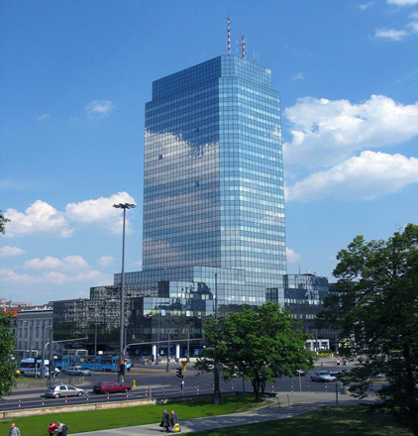
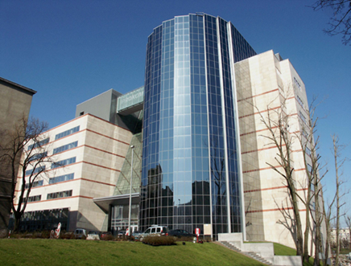
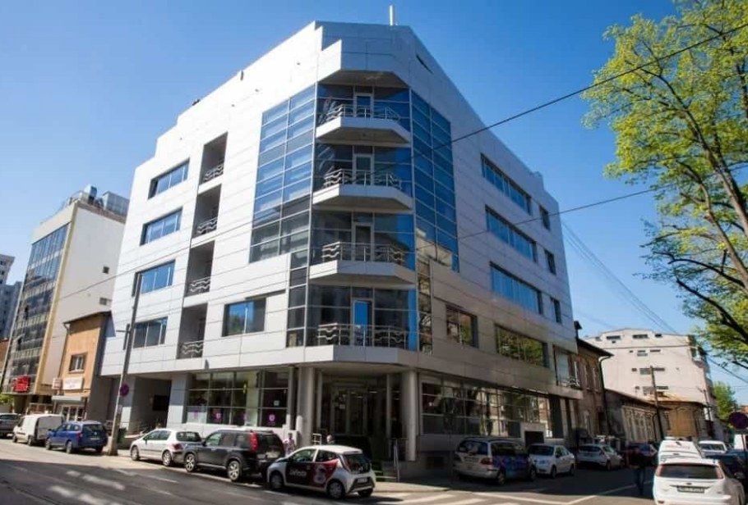
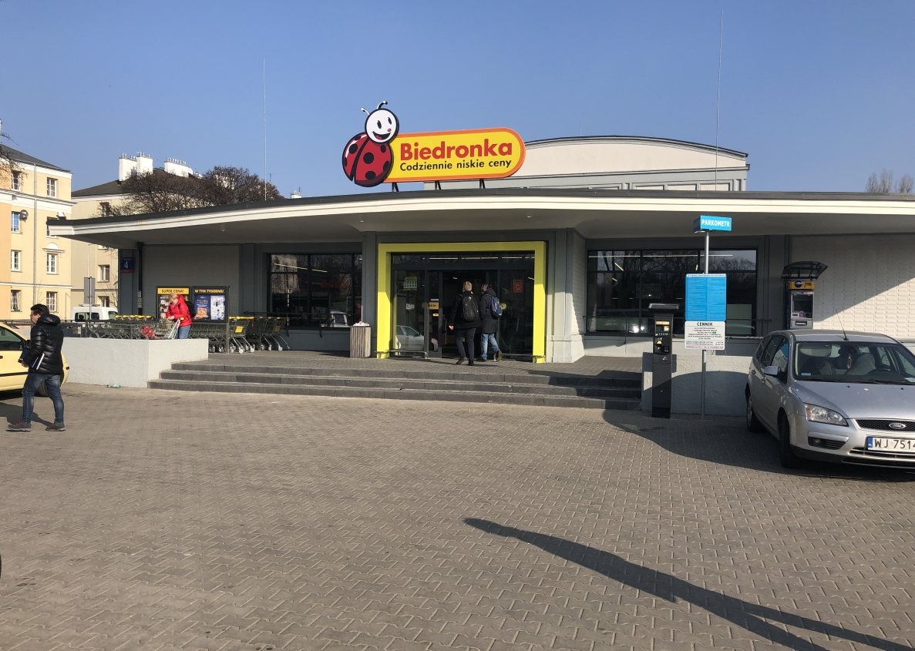
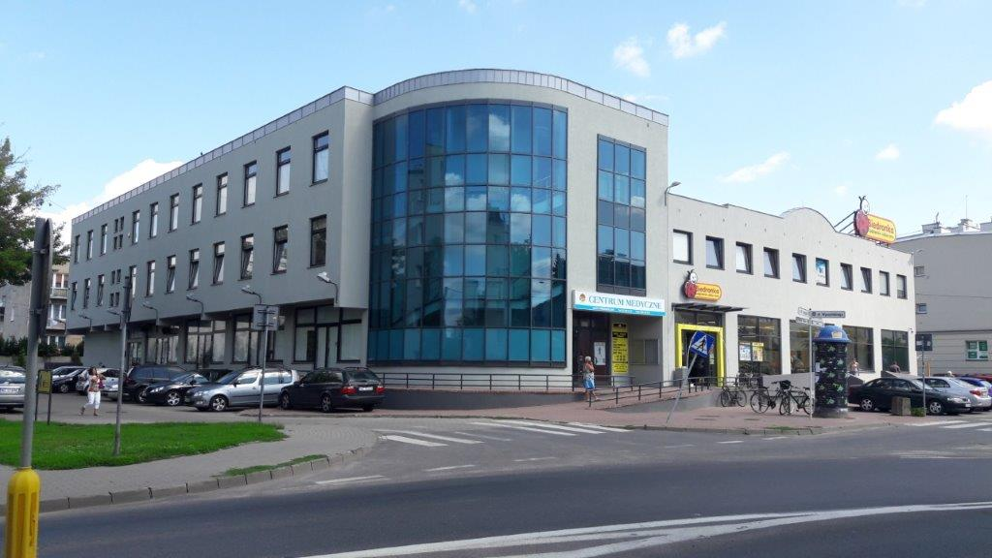
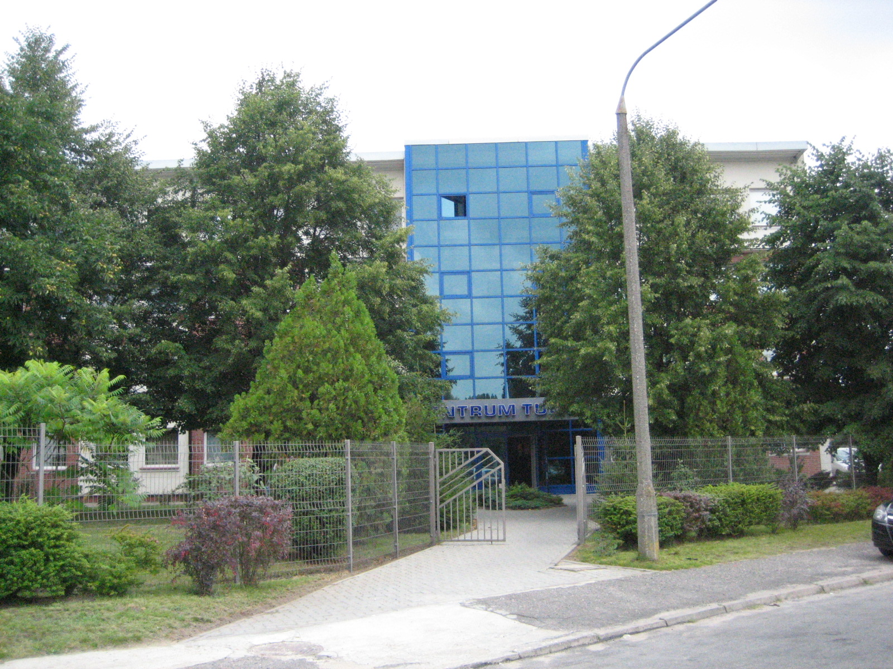
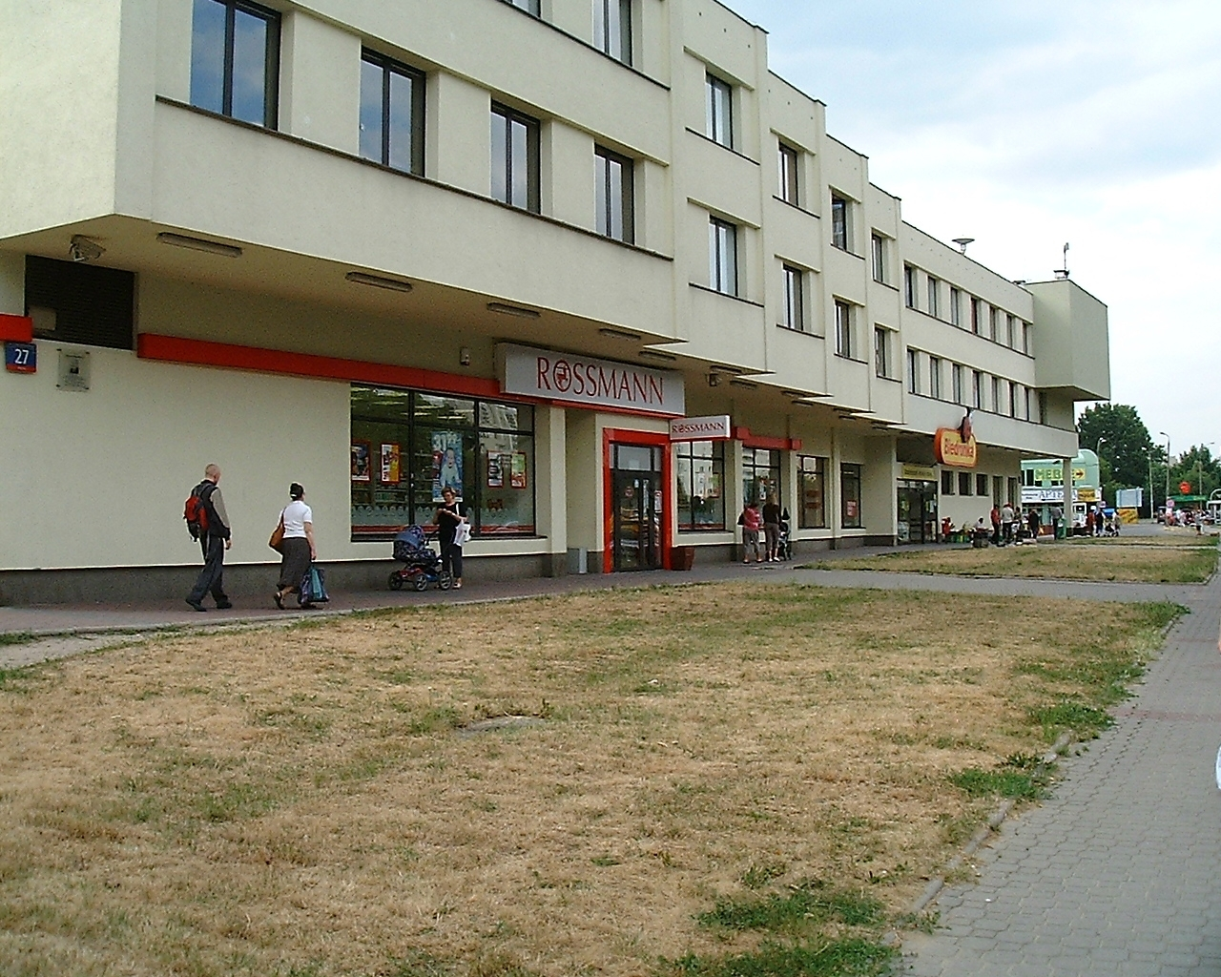
Praga, Warsaw
Segmental Analysis: Group Properties
7 directly owned properties at 31 March 2025
Blue Tower, Warsaw
(Fprop 80% share: c19,000 m²)
MV: £30.46m (€36.4m)
Gdynia, Poland
(c13,500 m²)
MV: £10.04m (€12.0m)
Dr Felix, Bucharest, Romania
(2,845 m²)
MV: £3.43m (€4.1m)
5th Property Trading Ltd: consolidated undertaking (47.2% shareholding)
MV: £8.26 (€9.7m)
E&S Estates Ltd:
supermarket (1,338 m²) in Praga, Warsaw
MV: £3.14m (€3.8m)
Mixed use (office and retail), Blonie, Warsaw:
MV: €3.4m (c2,300 m²)
Office building, Poznan
MV: €3.3m (c1,600 m²)
Ground floor retail, Mokotow, Warsaw
MV: €4.0m (c1,100 m²)
Wawer, Warsaw
(developed by Fprop)
33

Slide 34
Segmental Analysis: Group Properties
7 directly owned properties by geography, by asset class, by property
34

Slide 35
Segmental Analysis: Group Properties
7 directly owned properties
Contribution £3.79m (31 March 2024: Loss £3.90m) to Group PBT (prior to the deduction of unallocated central overheads);
Book value: £46.76m, Market value: £56.04m;
Activity in the year:
  Blue Tower, Warsaw:
    new lease signed over 3,100 sqm wef Dec-2024: should contribute c£800,000 pa to PBT.
    Paid £1.97m of deferred consideration. £4.87m remains to be paid (for purchase of additional 7,171 sqm in 2022).
  Fprop Gdynia SP Zoo, the company which owns the property in Gdynia, put into administration following failure to agree restructuring terms with its principal creditor.
  Tulipan, Poznan (owned by 5th Property Trading Ltd): Lease prolongation signed with Siemens for 5 years.
35

Slide 36
Segmental Analysis: Group Properties
7 directly owned properties
Location | Asset class | No. of properties | Book value at 31 March 2025 | Market value at 31 March 2025 | *Contribution to Group PBT 31 March 2024
Poland, Gdynia | Offices | 1 | £10.04m | £10.04m | £0.97m
Poland, Warsaw | Offices | 1 | £24.34m | £30.46m | (£0.21m)
Poland | Supermarkets | 1 | £2.06m | £3.14m | £0.08m
Romania | Offices | 1 | £2.20m | £3.43m | £0.27m
Poland | Multi use | 3 | £8.12m | £8.97m | £0.42m
Total* |  |  |  |  | £1.53m
Property Impairment | - | - | - | - | (£0.24m)
Other overhead costs allocated to the direct property division | - | - | - | - | (£1.34m)
Total |  | 7 | £46.76m | £56.04m | (£0.05m)
*Prior to the deduction of direct overhead and unallocated central overhead expenses;
36

Slide 37
Segmental Analysis: Group Properties
7 directly owned properties
 | 31 March 2025 | 31 March 2024
Book value | £46.76m | £45.76m
Market value | £56.04m | £51.90m
Gross debt (including £17.10m of non-interest bearing deferred consideration) | £24.37m | £27.62m
LTV at book value % | 52.12% | 60.36%
LTV at market value % | 43.49% | 53.22%
Weighted average borrowing cost | 2.8% | 2.8%
All debt is no recourse to the Group.
All bank loans are denominated in Euros, and all are used to finance properties valued in Euros.
The deferred consideration is in respect of Blue Tower (£4.88m) and the property in Gdynia (£10.04m).
37

Slide 38
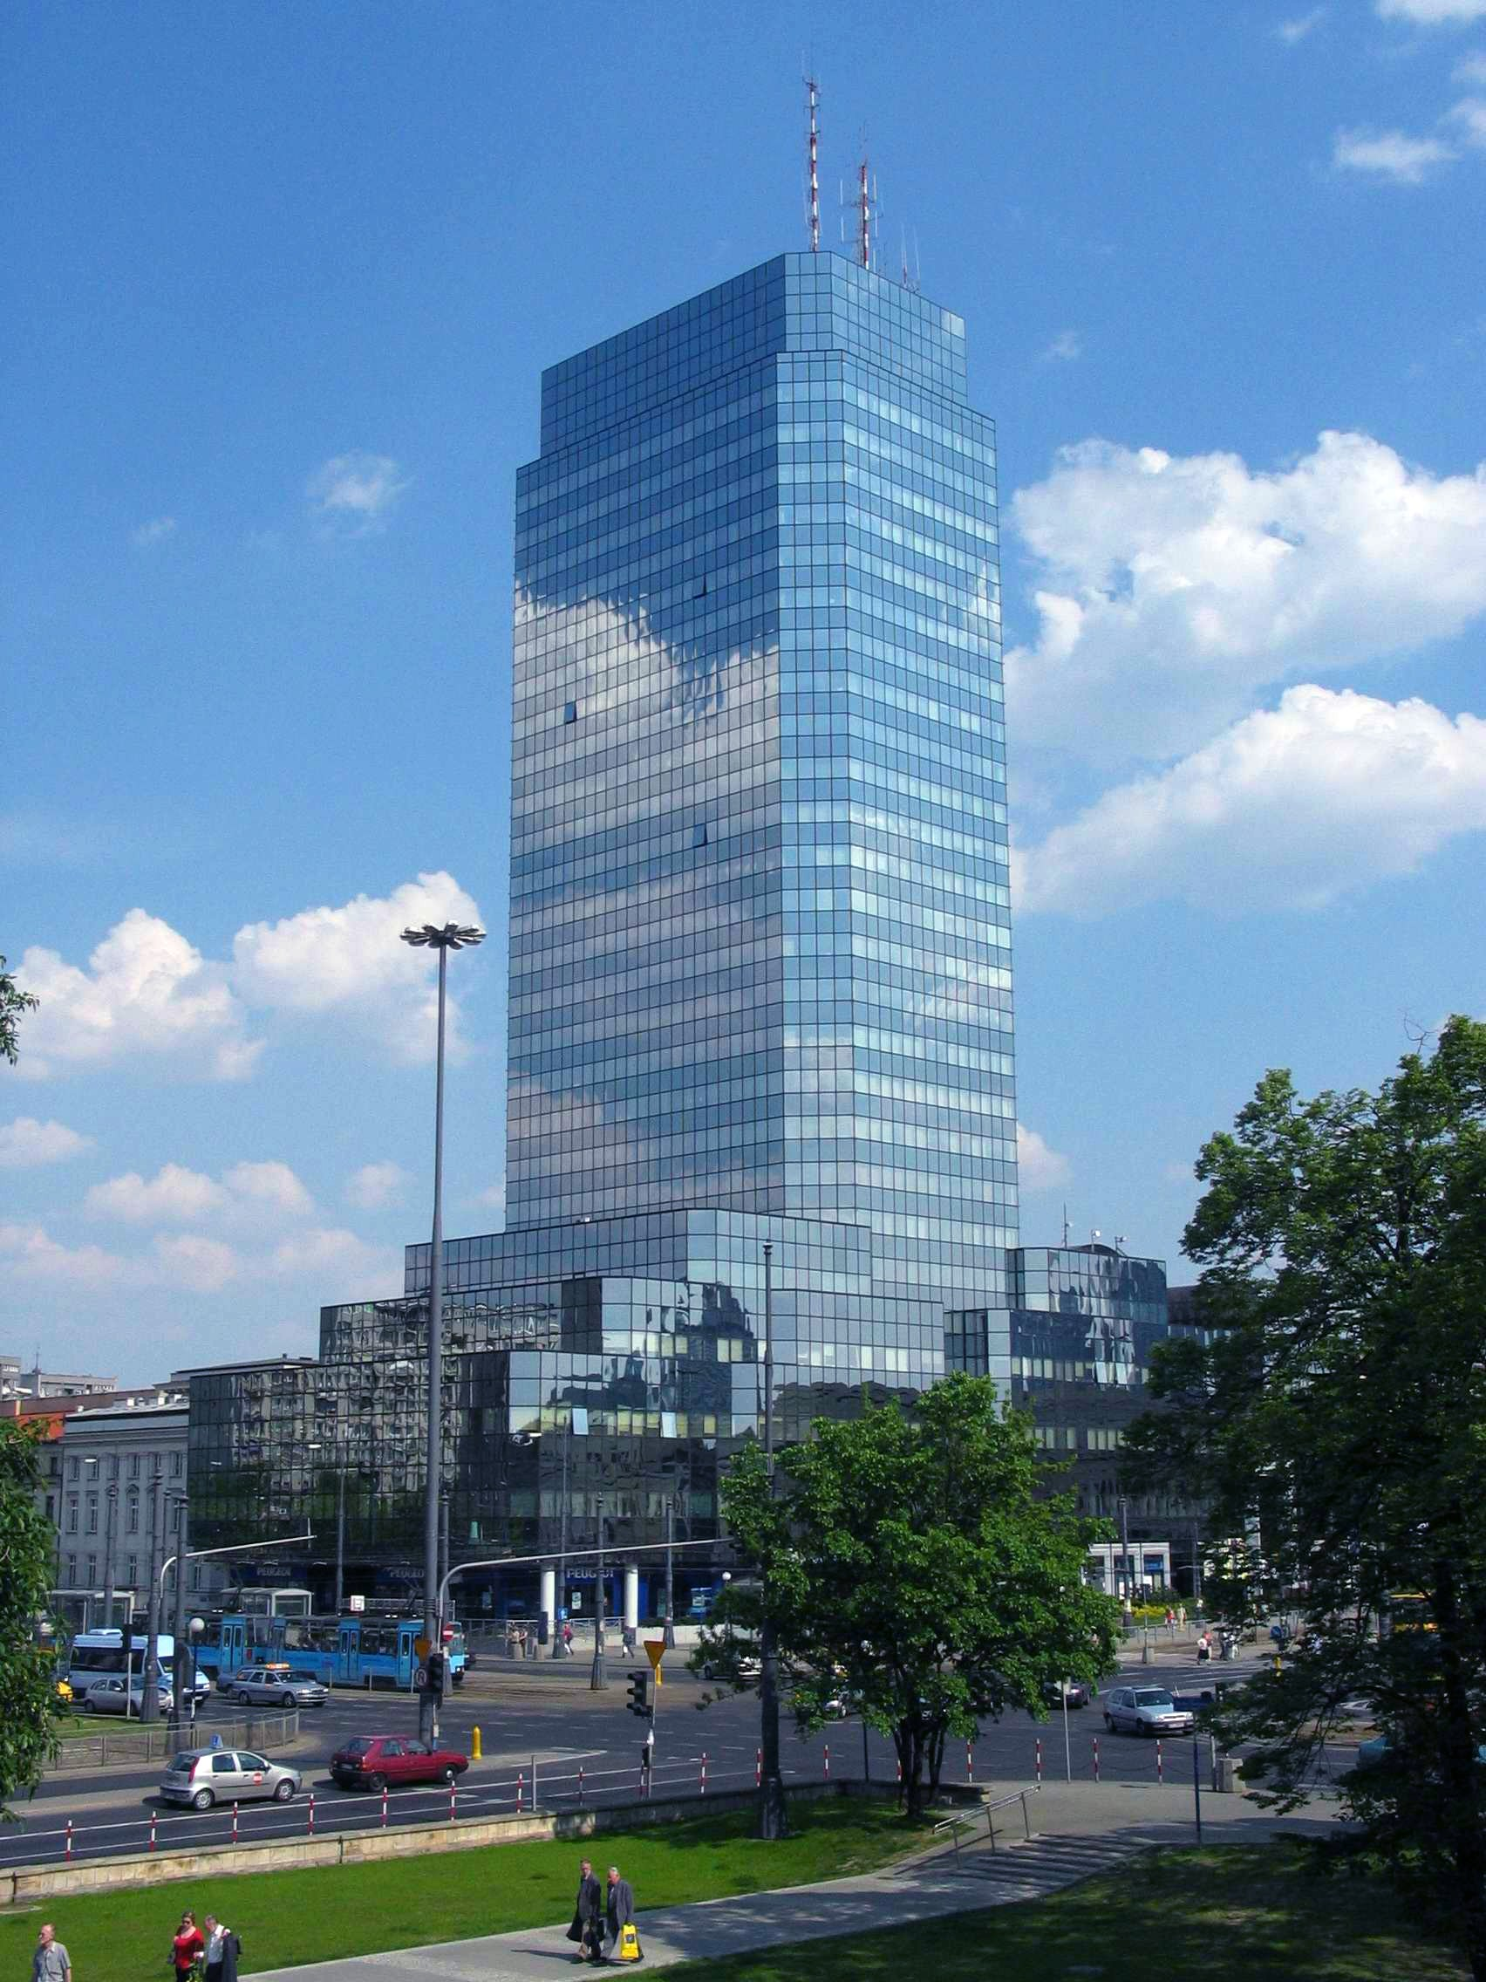
Segmental Analysis: Group Properties
Blue Tower (23,550 m² over 24 floors of offices), Warsaw
Prime location in Warsaw’s CBD above a subway station and at the main junction of the city’s bus and tram network.
The Group owns:
  80.3% of the tower (c19,000 m² over 18 office floors):
  90% of Corp Sp. z o.o., the company which is constitutionally tied to manage the building.
Leasing:
  Vacancy Rate: 10%
  NOI: €1.3m p.a.
  WAULT: 4 years, 5 months
Book value: £24.34m (£1,281 per m²)
Market value: €36.40m (£30.46m)
38

Slide 39

Segmental Analysis: Group Properties
Office Building (c13,500 m²), Gdynia, Poland
Prime location in Gdynia city centre/CBD;
Purchase price (Mar-2021): €16 million
(€1,194 per m²);
Equity invested: €4 million;
Leverage:
  Interest bearing debt: nil
  Deferred consideration: €12m (due FY 2025);
Vacancy rate:
  At purchase (Mar 2021): 98%
  31 Mar 2025: 69%
  31 Mar 2024: 71%
Net operating income (NOI):
  31 Mar 2025: €8,800 p.a.;
  If fully let: €2.2m p.a.
WAULT: 31 Mar 2025: 2 yrs, 6 mths
39

Slide 40
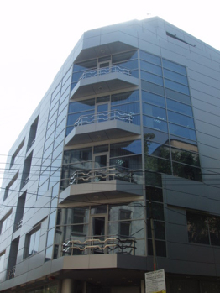
Segmental Analysis: Group Properties
Dr Felix St, Bucharest (2,845 m² over 7 floors)
Prime location in Bucharest’s CBD within walking distance from Victoriei Square, the financial centre of Bucharest.
Leasing:
  Vacancy Rate: 0%
  NOI: c€292k pa.
  WAULT: 6 yrs, 3 mths
Book value: £2.20m (£688 per m²)
Market value: €4.10m (€1,280 per m²)
Bank debt: Nil
40

Slide 41
5th Property Trading Ltd (5PT)
Consolidated Undertaking
5th Property Trading Ltd (5PT)
Ground floor retail units,
Mokotów, Warsaw
MV: €4.0m (c1,100 m²)
Office & Retail, Błonie, Warsaw
MV: €3.4m (c2,300 m²)
Office, Tulipan, Poznań
MV: €3.3m (c1.600 m²)
3 properties in Poland
Market value: €10.7m (£8.97m)
NOI: €766k p.a.
Vacancy rate: 16%
Main tenants: Jeronimo Martins, Siemens, Rossman
Leverage: 32% LTV
WAULT: 2 yrs, 6 mths
41

Slide 42
E and S Estates Ltd (E&S)
Consolidated Undertaking
E and S Estates Ltd (E&S)
Mini supermarket, Praga
1 supermarket in Praga, a suburb of Warsaw (1,338 m²)
Market Value: €3.75m (£3.14m)
NOI: €272,000 pa
Vacancy rate: nil
Tenant: Jeronimo Martins
Leverage: c43% LTV
WAULT: 10 yrs, 7 mths
42

Slide 43
Segmental Analysis: Group Properties
Top 10 tenants of the 7 directly owned properties
 | Tenant | Sector | Jurisdiction | %
1 | Jeronimo Martins | Supermarket Chain | Poland | 26.56%
2 | TV Republika | Media | Poland | 15.60%
3 | Miasto Stołeczne Warszawa | Government | Poland | 10.44%
4 | Sąd Rejonowy w Gdynia | District Court | Poland | 6.67%
5 | HRK | HR | Poland | 6.65%
6 | Vulpoi & Toader Management | Professional / Accounting Services | Romania | 6.13%
7 | Krajowy Ośrodek Wsparcia Rolnictwa | National Agricultural Support | Poland | 4.48%
8 | Turkusowa sp. z o.o. | Construction | Poland | 2.20%
9 | Rossmann | Chemists | Poland | 2.07%
10 | No Fluff Jobs | IT Recruitment | Poland | 1.99%
% of rental income attributable to top 10 tenants |  |  |  | 82.79%
Weighted Average Unexpired Lease Term (WAULT) = 4 years, 10 months (31 March 2024: 4 years, 10 months)
Vacancy rate = 29% (8.9% excluding Gdynia)
43

Slide 44
Segmental Analysis: Group Properties
Associates and Investments
Associates and Investments
(minority shareholdings in 9 of FPAM’s 11 funds)
44

Slide 45
Segmental Analysis: Group Properties
Associates and Investments
Contribution of £3,211,000 (31 March 2024: £112,000) to Group PBT (prior to the deduction of unallocated central overheads).
Increase vs FY 2024 mainly (£1.73m) from the Group’s 23% share in FPL plus cash distributions of £0.42m from its share in UK PPP and Spec Opps.
Book value of the five associates: £20.06 million (31 March 2024: £17.28 million).
Market value: £20.94 million (31 March 2024: £17.64 million).
Value of the four investments in funds: £1.67 million (31 March 2024: £2.62 million). Reduction vs FY 2024 mainly due to sale of 19 properties held by two UK funds (UK PPP and Spec Opps) during the year.
45

Slide 46
Segmental Analysis: Group Properties
Associates and Investments
Fund | % owned by First Property Group | Book value of First Property's share in fund | Current market value of holding | Group’s share of post-tax profits earned by fund 31 March 2025 | Group’s share of post-tax profits earned by fund 31 March 2025
a) Associates: | % | £’000 | £’000 | £’000 | £’000
FOP | 45.71% | 12,539 | 12,539 | (141) | 293
FGC | 29.09% | 2,968 | 3,189 | 202 | 289
FKR | 18.07% | 1,090 | 1,090 | (64) | (426)
FPL | 23.38% | - | - | (60) | (848)
FCL | 21.17% | 652 | 818 | 41 | 64
Sub Total: |  | 17,275 | 17,636 | (22) | (628)
b) Investments:
UK PPP | *0.94% | 196 | 196 | 23 | 23
Fprop UK Spec Opps | 11.06% | 2,142 | 2,142 | 5 | 1,196
Fprop Offices | 1.64% | 461 | 461 | 83 | 74
Fprop Fulcrum Property | 2.50% | 174 | 174 | 23 | 9
Sub total: |  | 2,973 | 2,973 | 134 | 1,302
Total: |  | 20,248 | 20,609 | 112 | 869

Slide 47
Segmental Analysis: Group Properties
Associates and Investments
Minority shareholdings in 5 of FPAM’s 12 funds accounted for as Associates
(FOP, FPL, FGC, FCL, FKL)
47

Slide 48
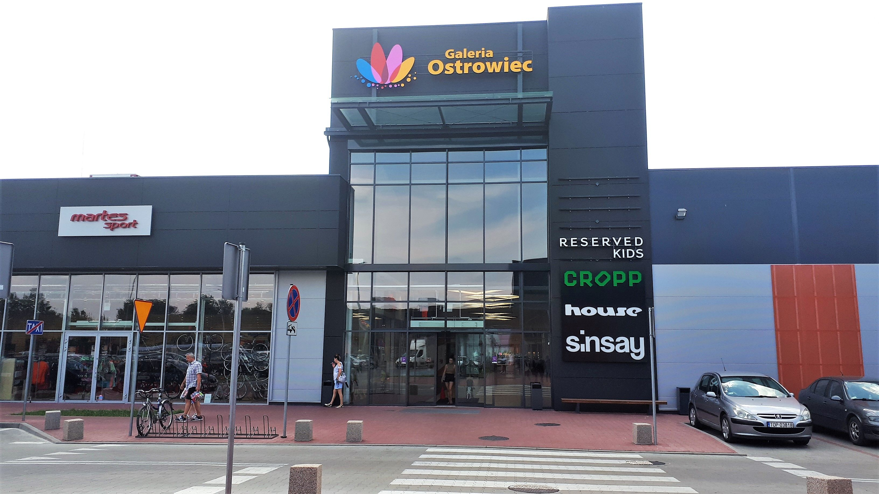
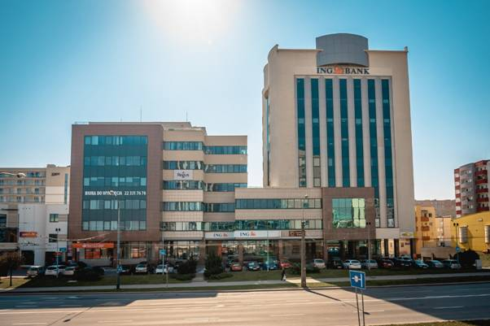
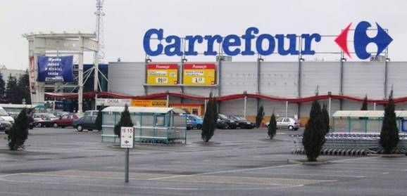
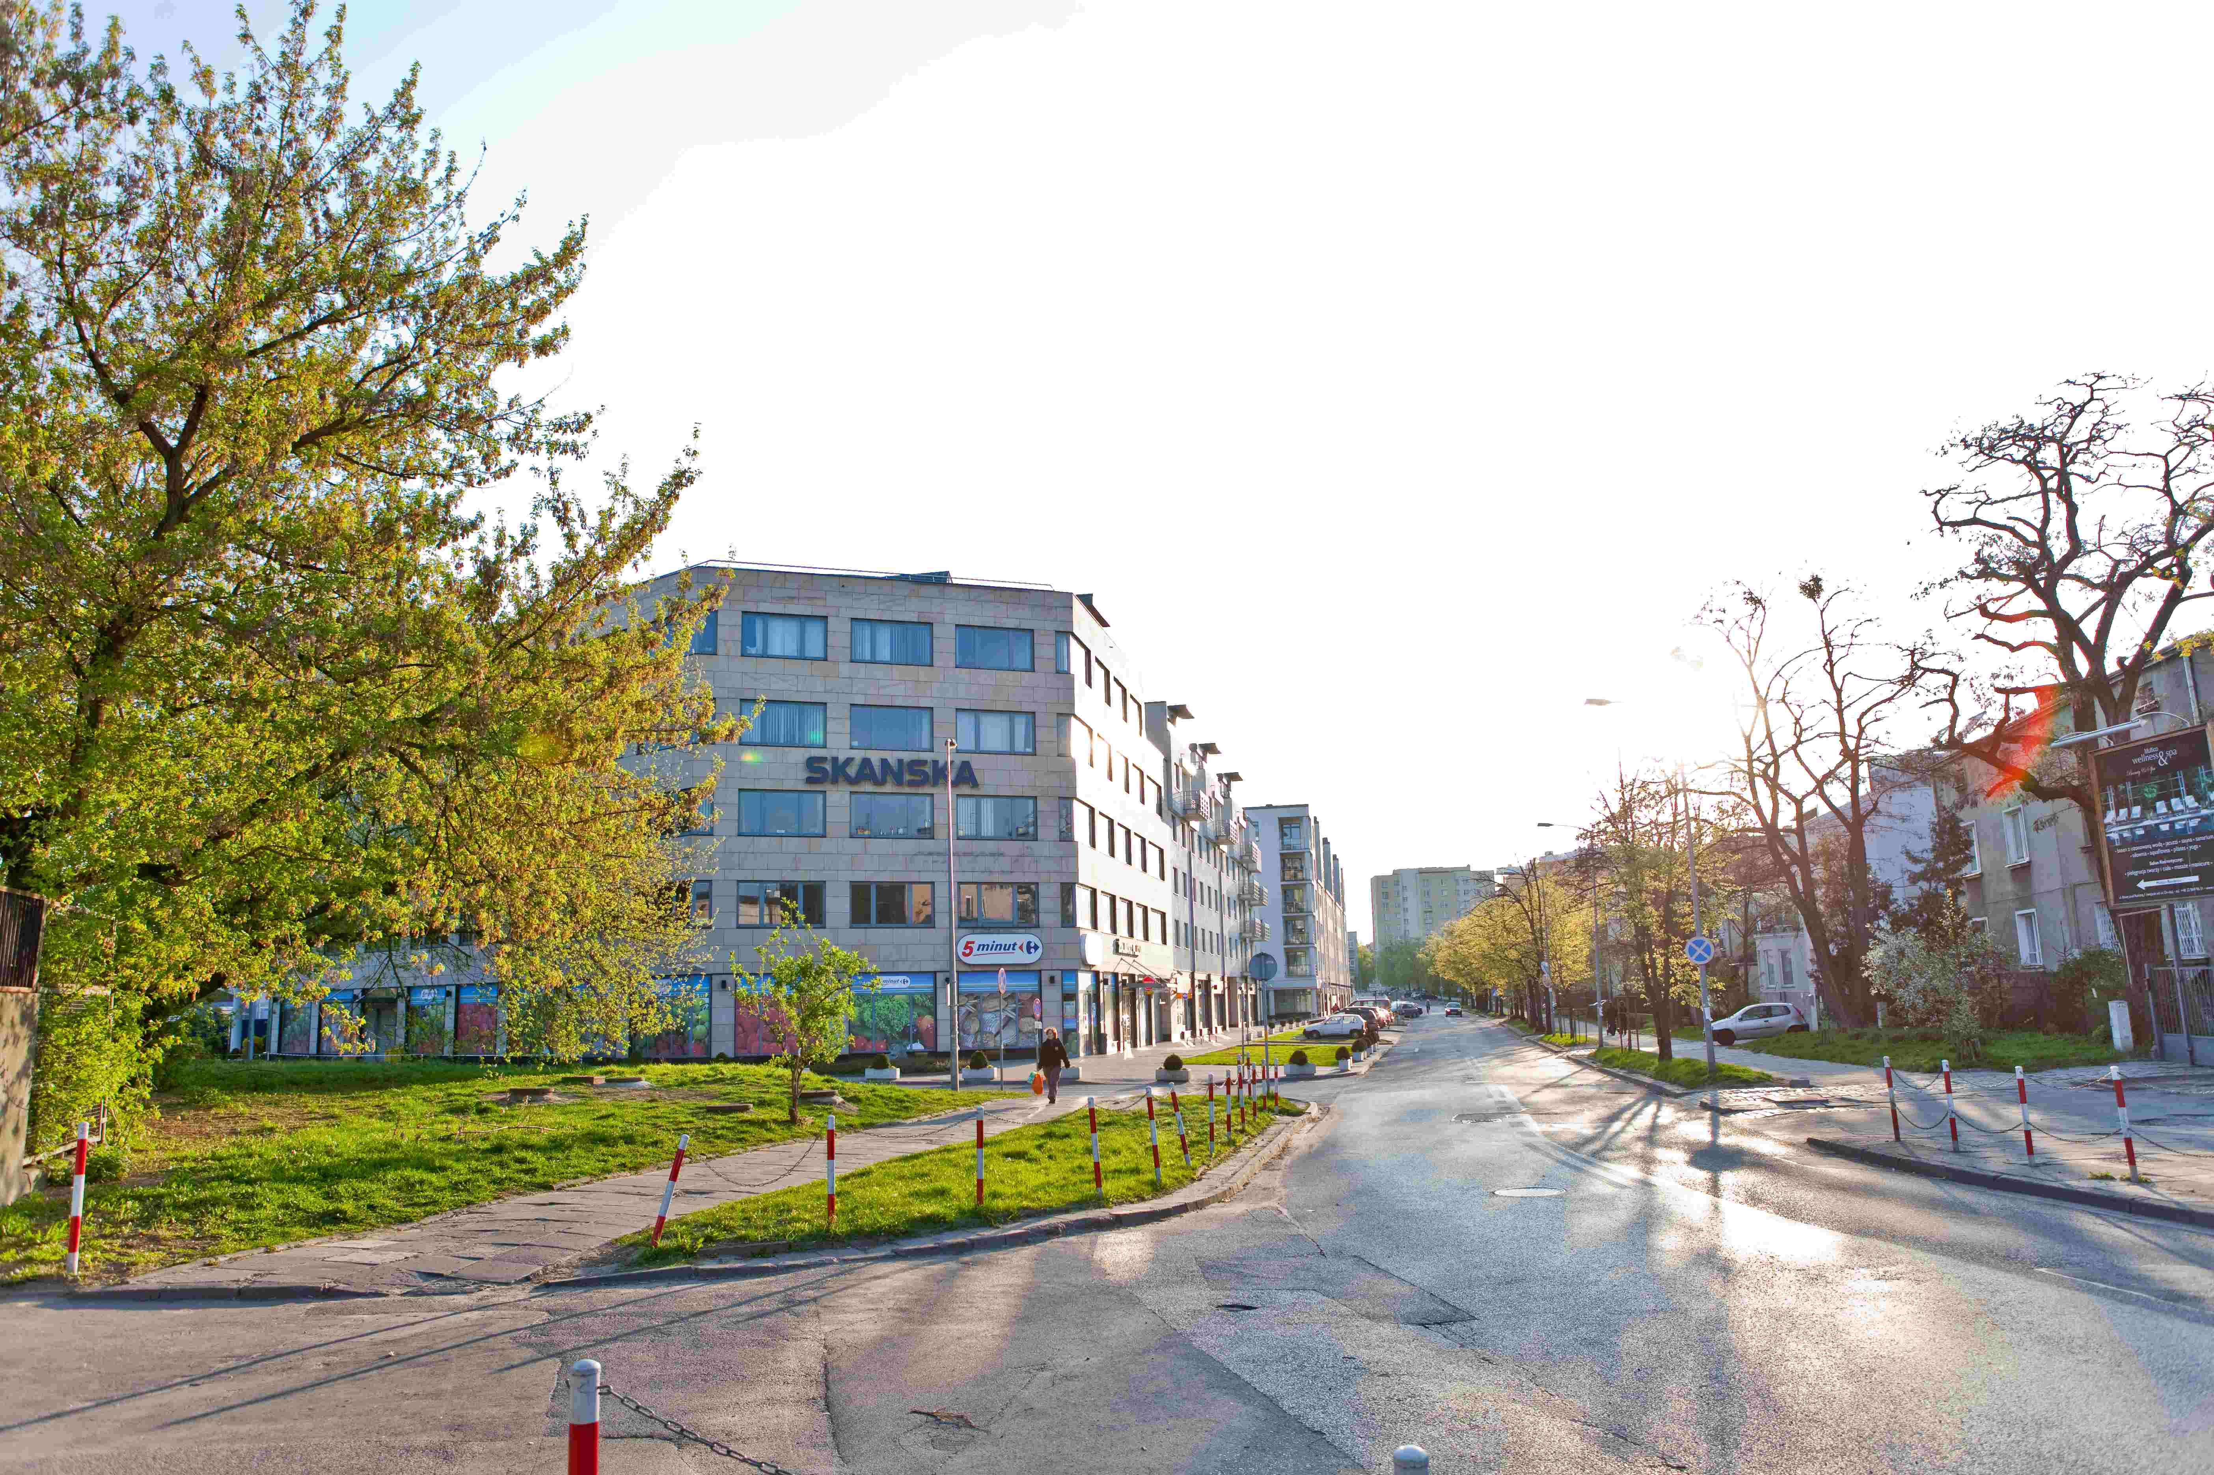
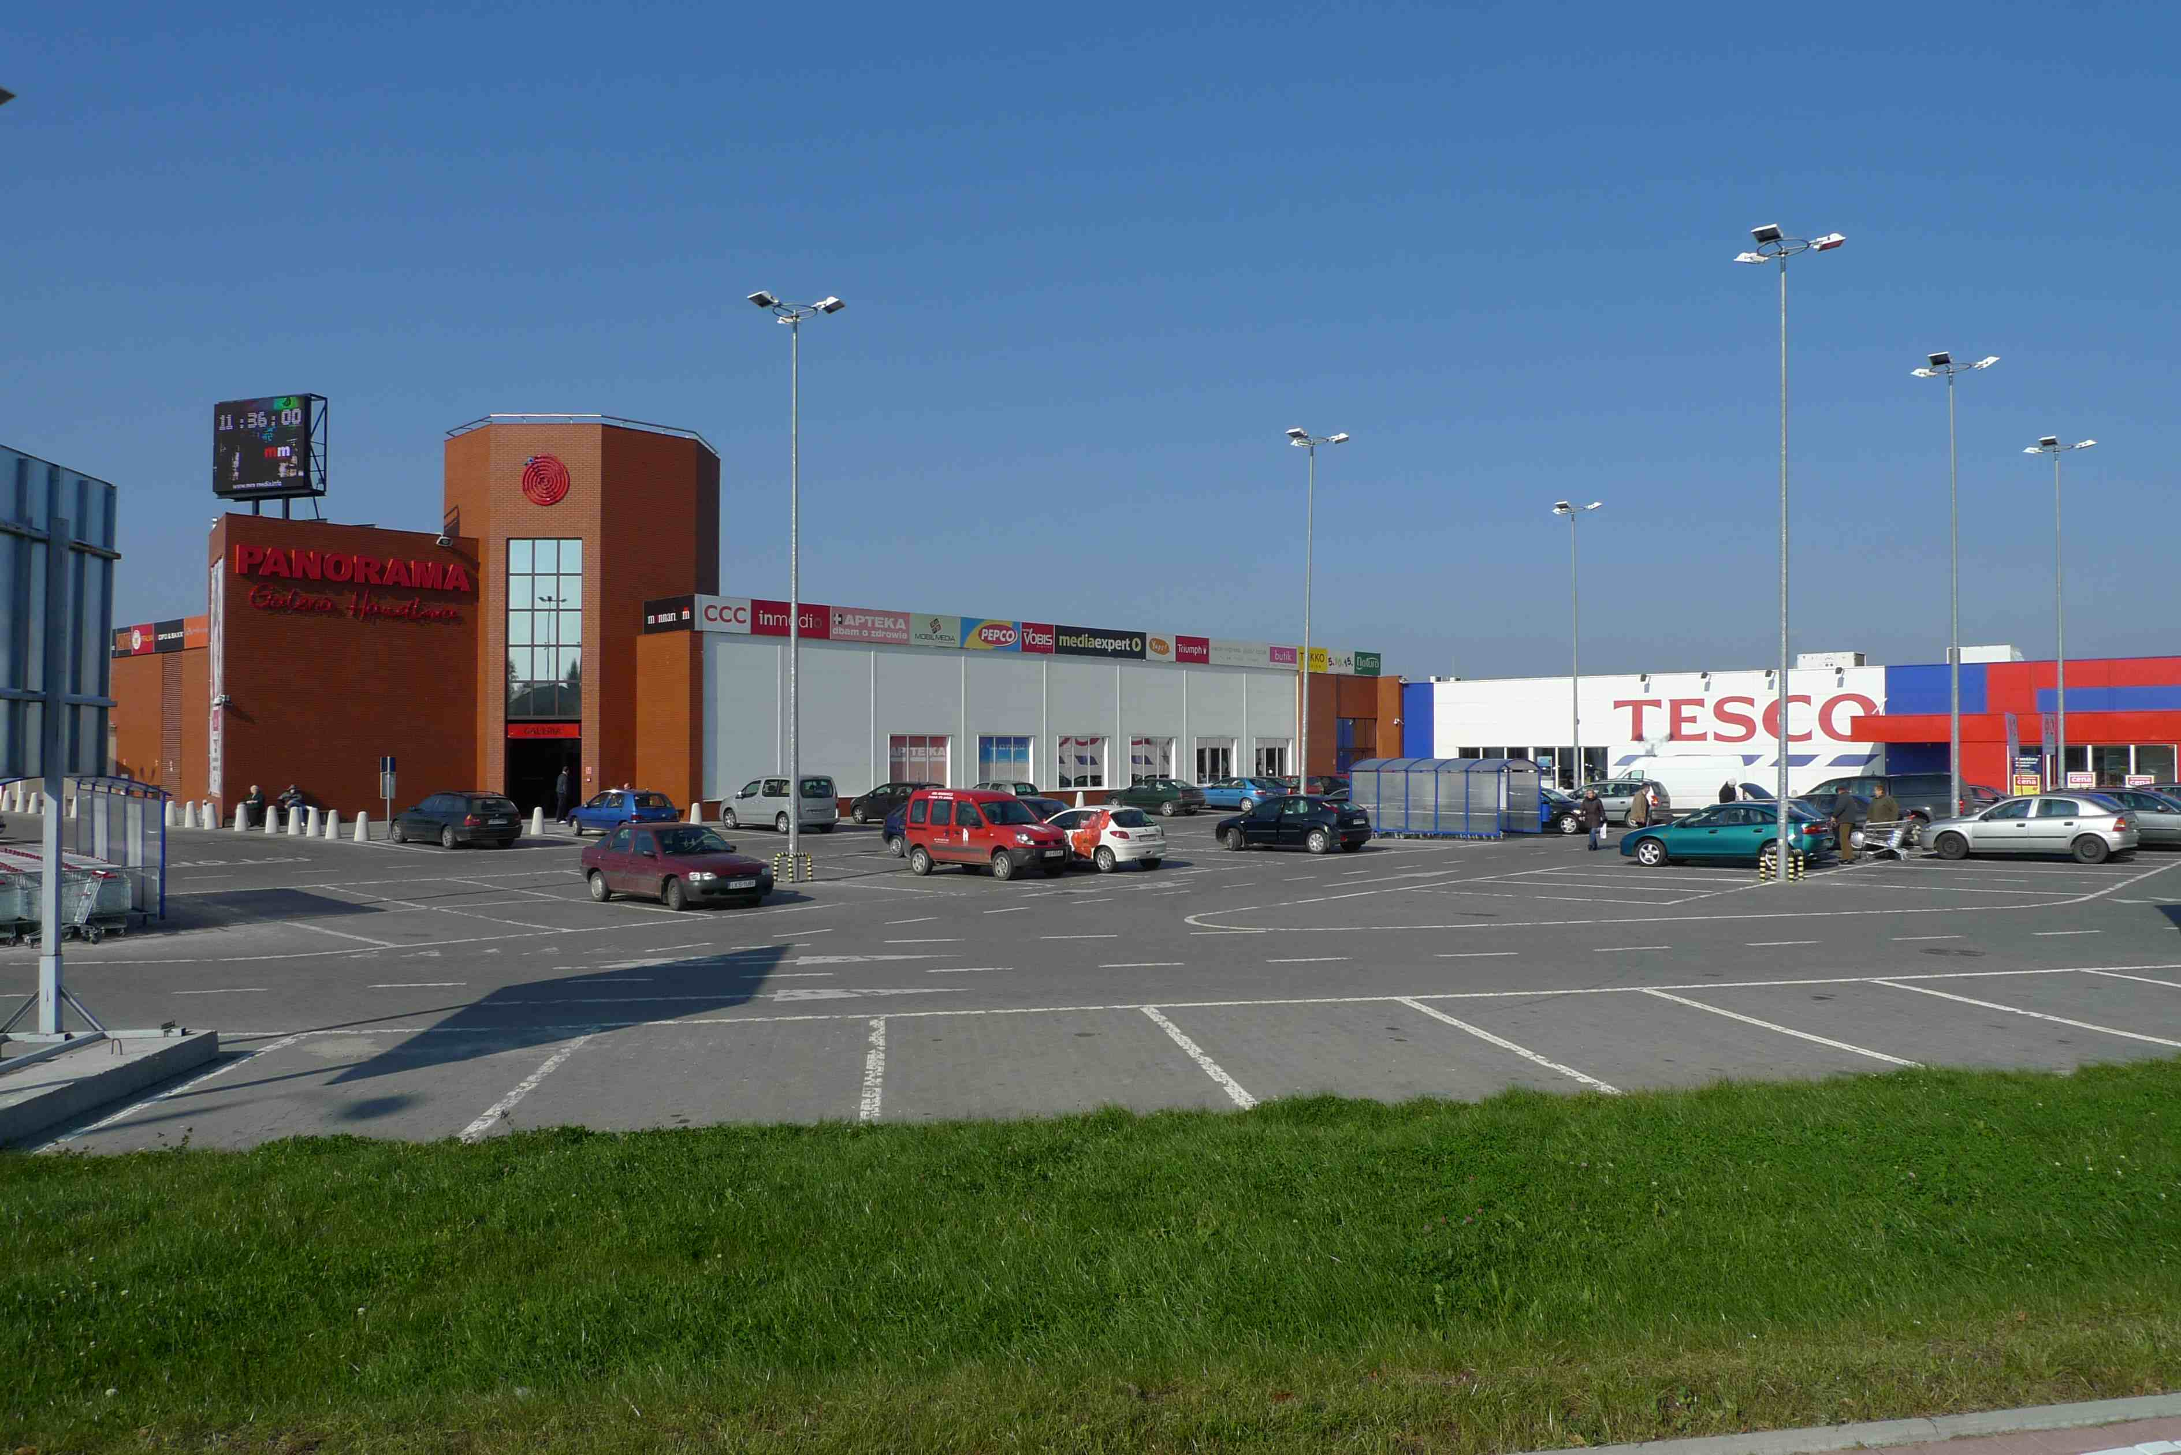
Fprop Opportunities plc (FOP)
Associates & Investments
Fprop Opportunities plc (FOP)
BV of Group’s 45.7% share: £13.48m
MV of Group’s 45.7% share: £13.48m
Contribution to PBT of Group’s share: £944k
Comments:
Galeria Ostroweic:
  Rent for anchor tenant (Carrefour) scheduled to rise by €95,000 September 2026;
Zana 39:
  Vacancy Rate: c15% (1,511 m²). If let NOI should increase by c€260,000 p.a.
Galeria Ostrowiec (19,400 m²)
Zana 39, Lublin (10,600 m²)
Hypermarket, Łódź (15,900 m²)
Żoliborz Plaza, Warsaw (5,400 m²)
5 properties in Poland
Property value: €71.5m
Leverage: 49% LTV
NOI: €6.10m p.a.
Vacancy Rate: 4.4%
WAULT: 2 yrs, 5 mths
Main tenant: Carrefour (25% of NOI, in Ostrowiec & Lodz)
Galeria Krasnystaw (5,300 m²)
48

Slide 49
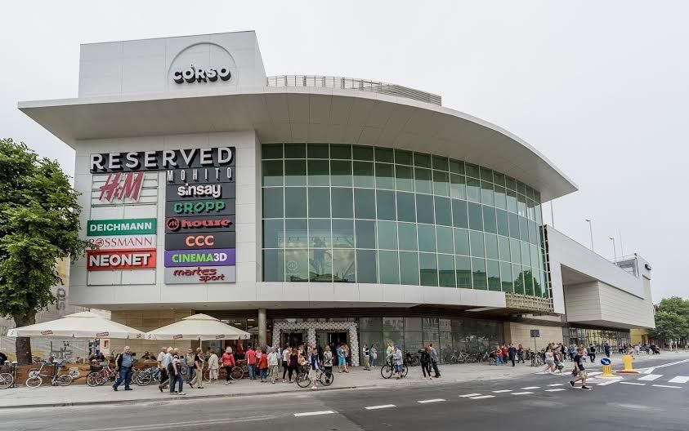
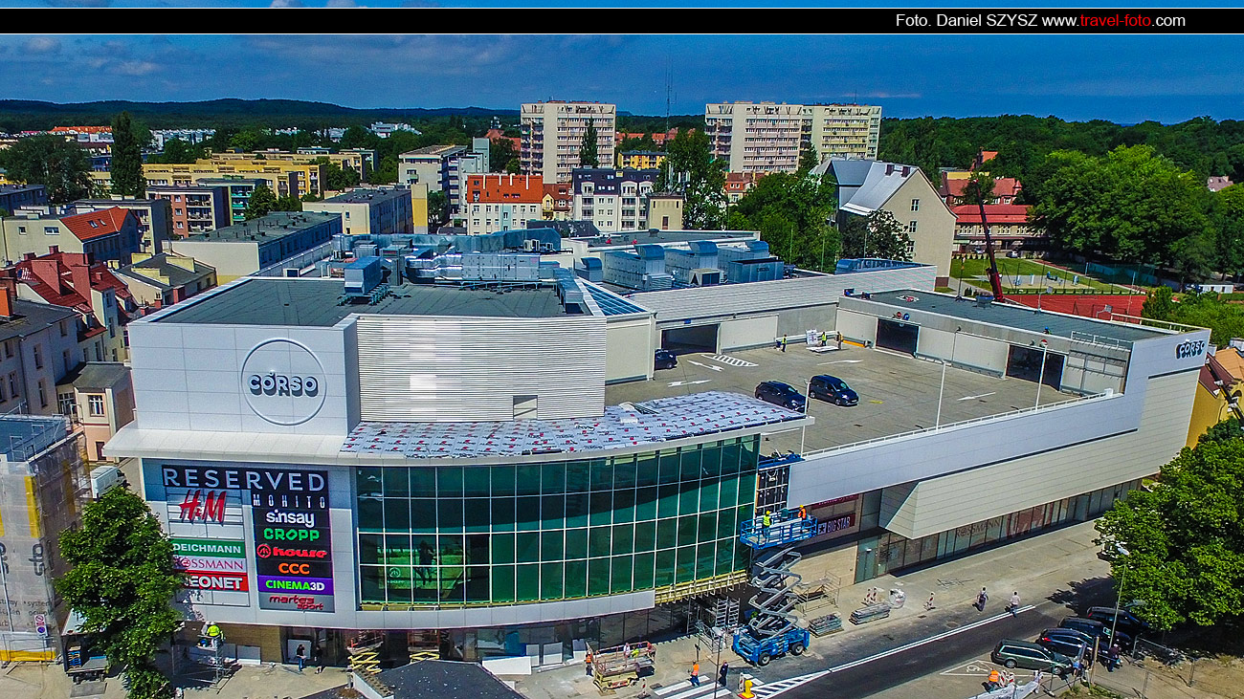

Fprop Galeria Corso Ltd (FGC)
Associates & Investments
Fprop Galeria Corso Ltd (FGC) – shopping centre in Świnoujście, Poland
10,000 m²
45 stores, 4 cinema screens, 160 parking places
Property value: €28.5m
NOI: c€2.3m p.a.
Vacancy rate: 0.11%
Main tenants: LPP, H&M, Rossman, Jaroslaw Figiel, Multikino, Martes Sport, Deichmann, Pepco Poland, Douglas Polska, Homla
Leverage: 42% LTV
WAULT: 2 yrs, 9 mths
https://galeriacorso.pl/
BV of Group’s 29.1% share: £3.21m
MV of Group’s 29.1% share: £3.96m
Contribution to PBT from Group’s share: £242k
Comments:
Excellent town centre location;
Major tourist destination, trade increases in summer months;
Benefits from proximity to Poland’s border with Germany.
49

Slide 50
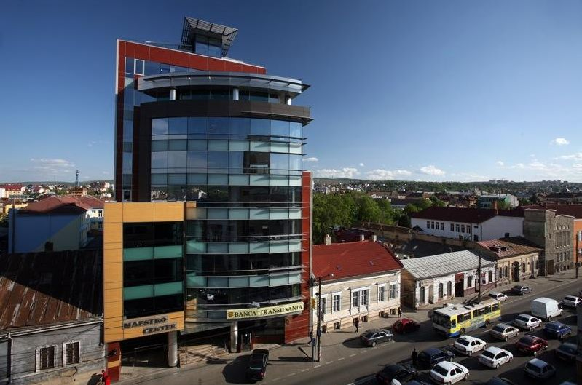
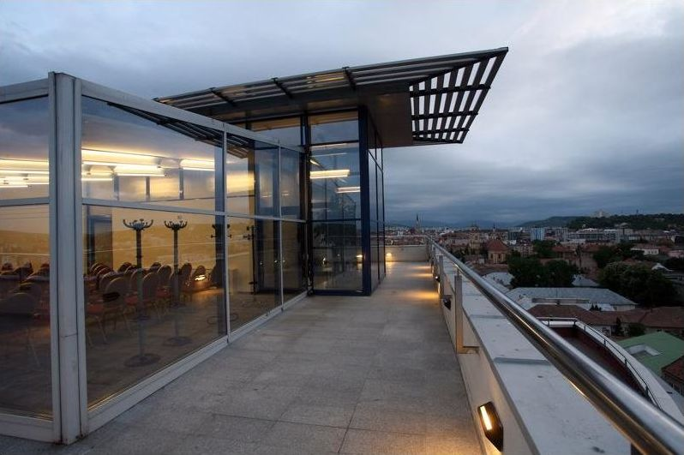
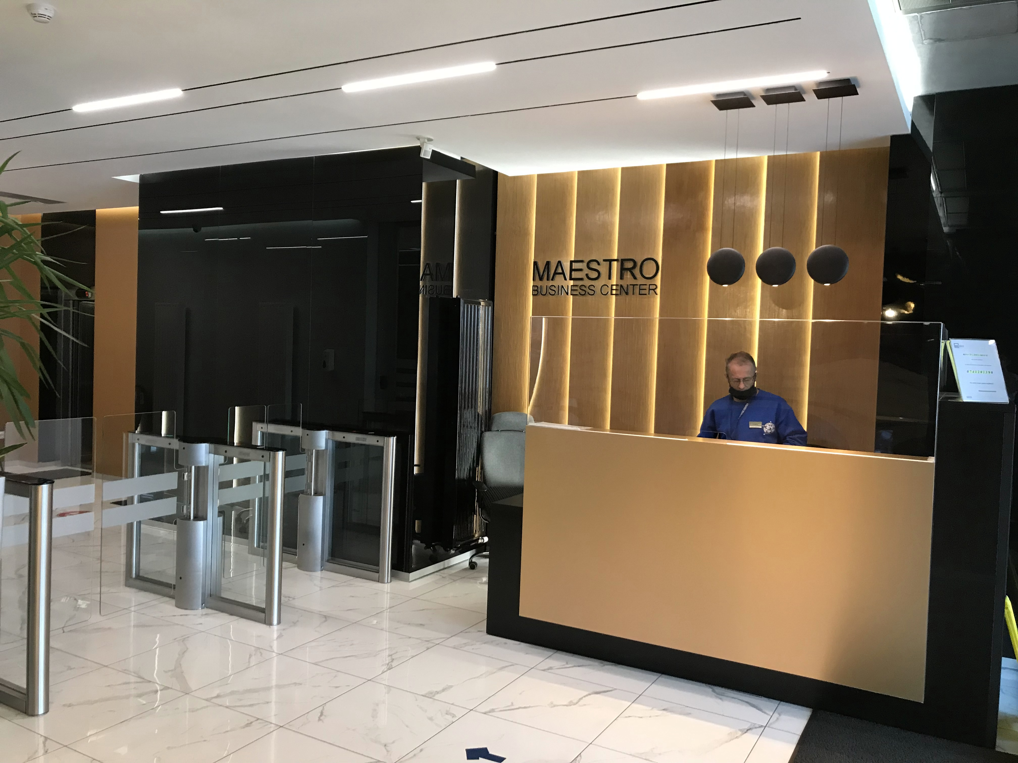
Fprop Cluj Ltd (FCR)
Associates & Investments
Fprop Cluj Ltd (FCL) – Class A office tower in Cluj-Napoca, Romania
7,289 m² (9 storeys)
43 underground parking places
NOI: €835k
Vacancy rate: 6.6%
6 tenants
WAULT: 2 yrs, 2 mths (1 yr, 2 mths to breaks)
Eco Rating: BREEAM Excellent
Property value: €9.6m
Book value of Group’s 21.2% share: £0.68m
Market value of Group’s 21.2% share: £0.78m
Contribution to PBT from Group’s share: -£2k
50

Slide 51
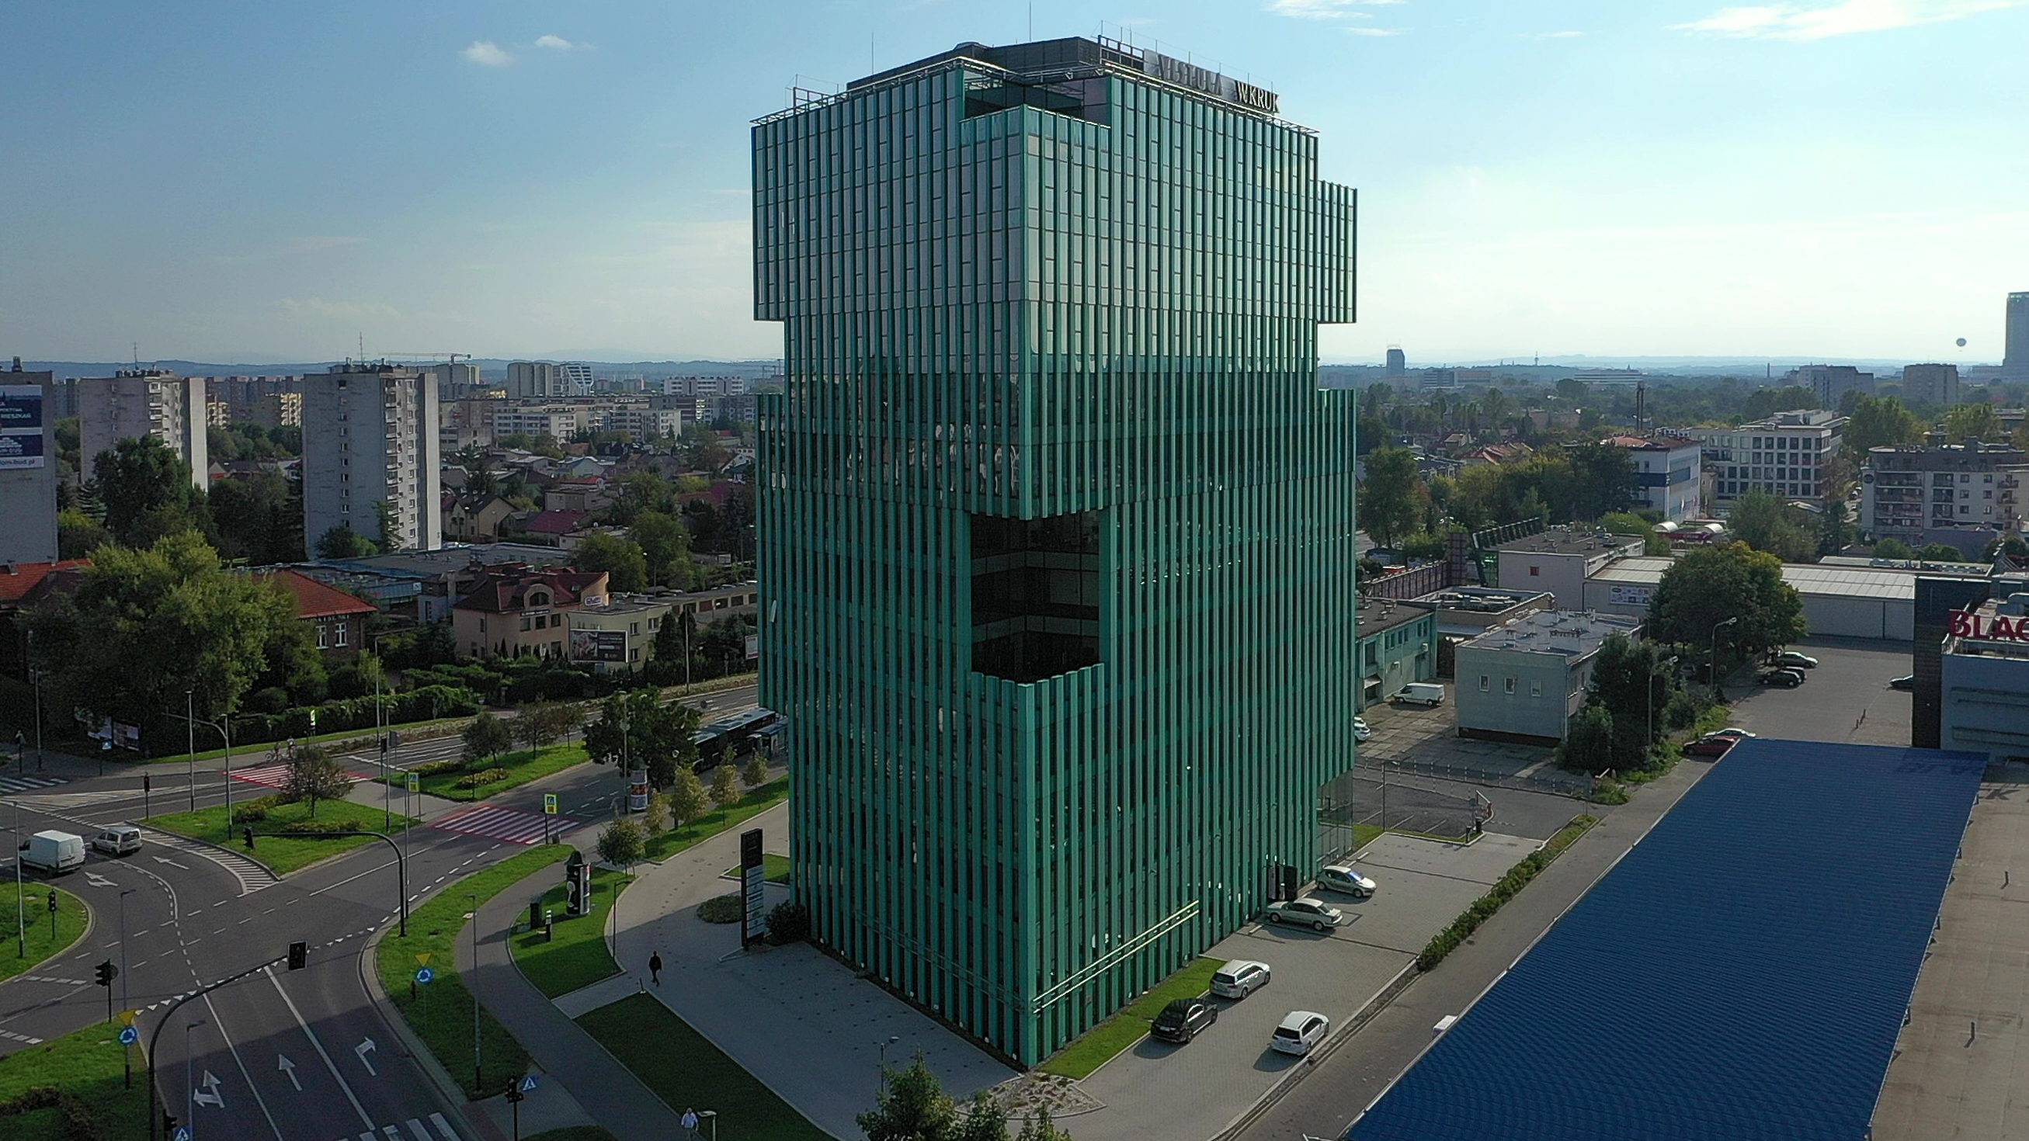
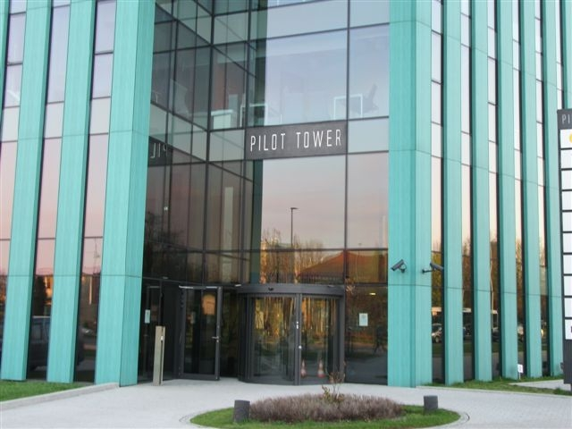
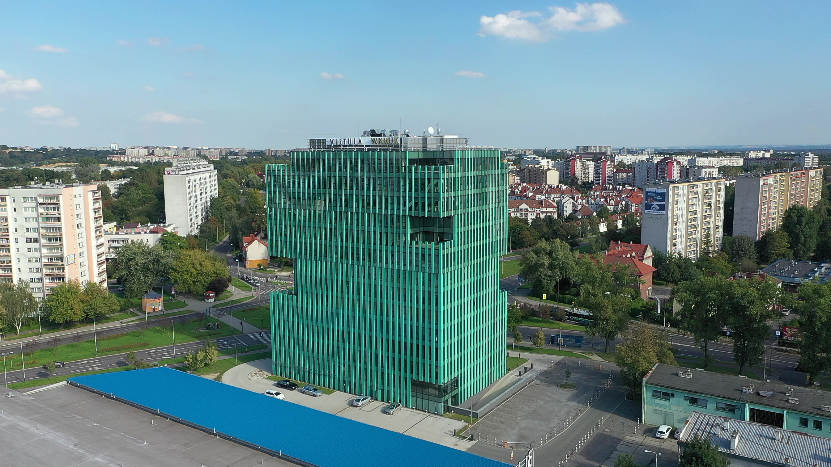
Fprop Kraków Ltd (FKR)
Associates & Investments
Fprop Krakow Ltd (FKL) – Class A office tower in Krakow, Poland
10,297 m² (13 storeys)
149 underground parking places, 26 at ground level
Eco Rating: LEED Platinum
9 tenants
NOI: €1.32m p.a.
Vacancy Rate: 27%
WAULT: 1 yrs, 5 mths
Property value: €18.51m
https://pilottower.pl/
Book value of Group’s 18.1% share: £0.96m
Market value of Group’s 18.1% share: £0.96m
Contribution to PBT from Group’s share: (£128k)
Comment:
Office vacancy rate in Krakow: 20%
Well located on Kraków’s 2nd ring road, 4km’s from city centre, 2km’s from central railway station, on 16 bus routes.
51

Slide 52
Segmental Analysis: Group Properties
Associates and Investments
Minority shareholdings in 4 of FPAM’s 11 funds accounted for as Investments
(UK PPP, Fprop Offices, Spec Opps, Fulcrum)
52

Slide 53
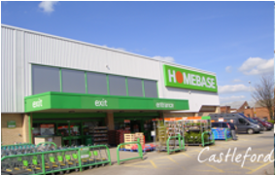
UK Pension Property Portfolio LP
Associates & Investments
UK Pension Property Portfolio (UK PPP)
1 remaining property
Value: £2.6m
Rental Income: £328,000 p.a.
WAULT (to breaks): 9 years 4 months
Book value of Group’s 0.94% share: £25,000
Market value of Group’s 0.94% share: £25,000
Contribution to PBT from Group’s 0.94% share: £54,697
NB. Fprop UK Special Opportunities LP (see next page), in which the Group is an 11.1% shareholder, has a 49.7% interest in UK PPP. As a result, the Group’s total interest in UK PPP equates to 6.4%.
53

Slide 54
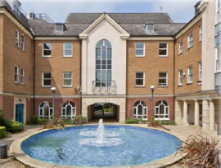
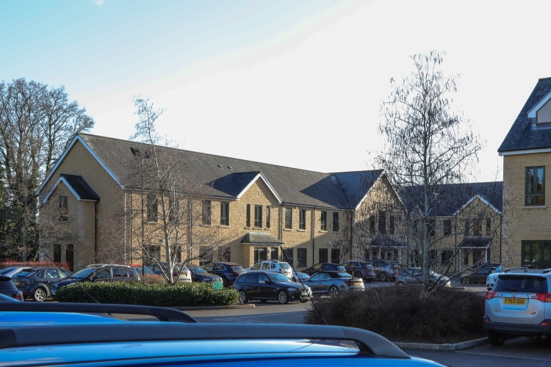
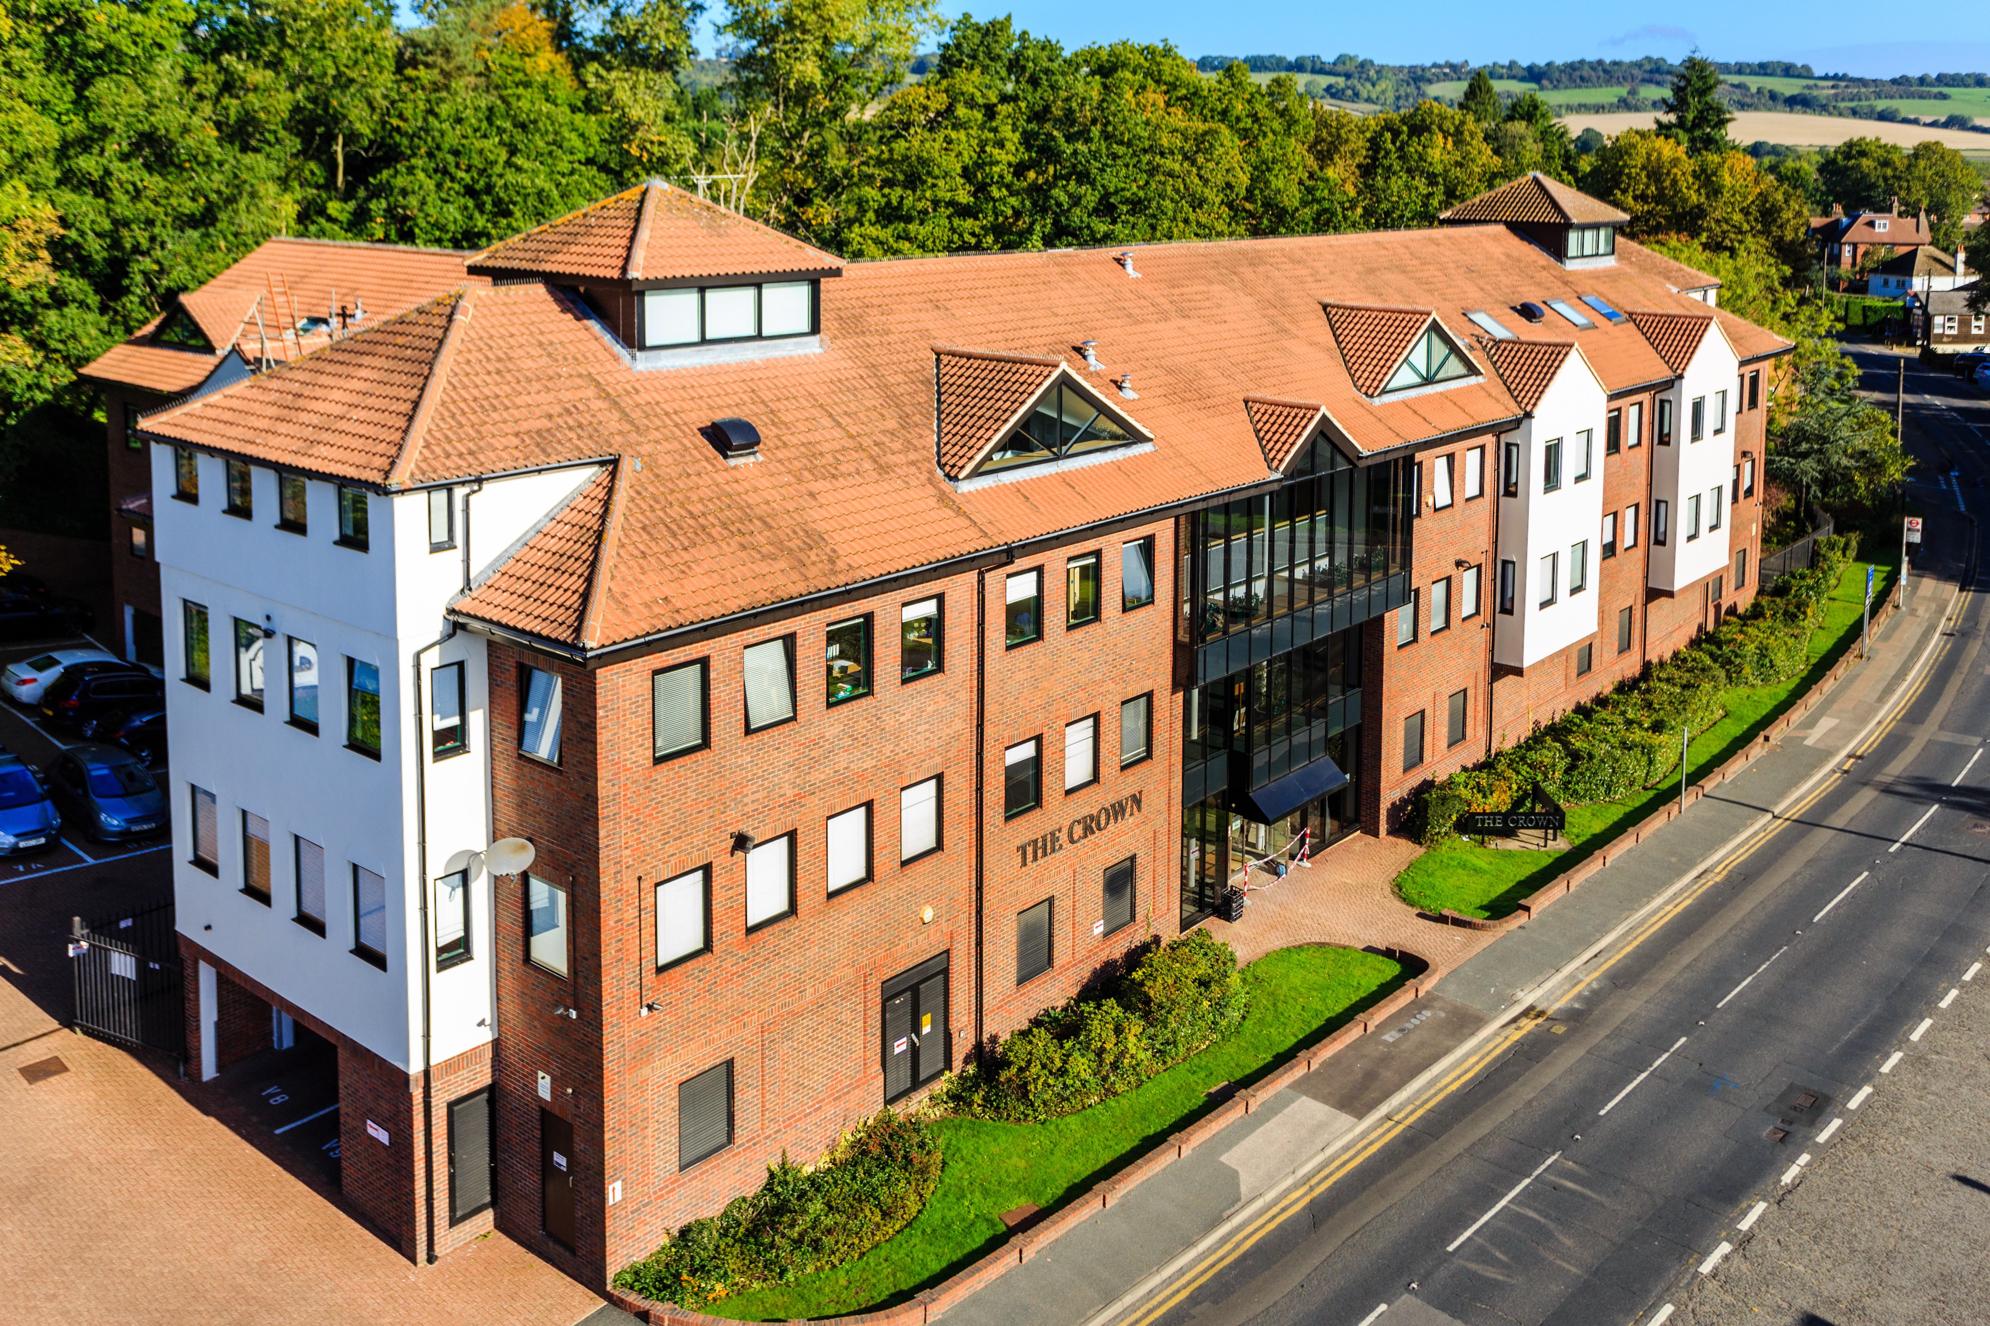
Fprop UK Spec Opps LP
Associates & Investments
St Anne’s House,
St Anthony’s House &
St.Catherine’s House,
Newbury
Cirencester Office Park
The Crown, Westerham
Fprop UK Special Opportunities LP
3 directly held properties valued at £9.5m
49.7% share in UK PPPP (see previous page)
valued at £1.35m
Net Assets: £11.0m
Book value of Group’s 11.1% share: £1.16m
Market value of Group’s 11.1% share: £1.16m
Contribution to PBT from Group’s 11.1% share: £367k
54

Slide 55
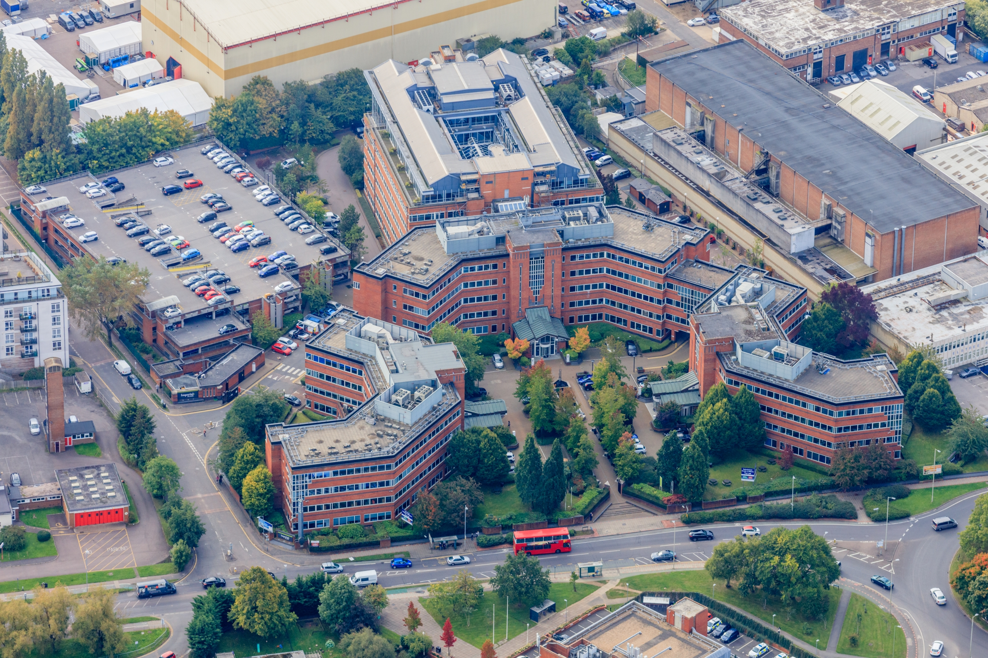
Fprop Offices LP
Associates & Investments
Imperial Place, Borehamwood
Fprop Offices LP
1 remaining property
Value: £27.5m
Book value of Group’s 1.64% share: £344,000
Market value of Group’s 1.64% share: £344,000
Contribution to PBT from Group’s 1.64% share (YTD): £Nil
55

Slide 56
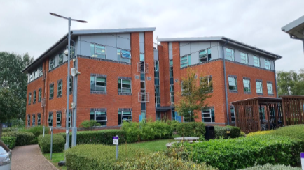
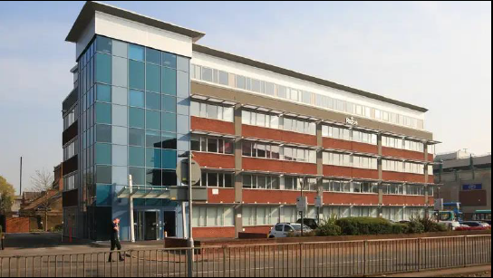
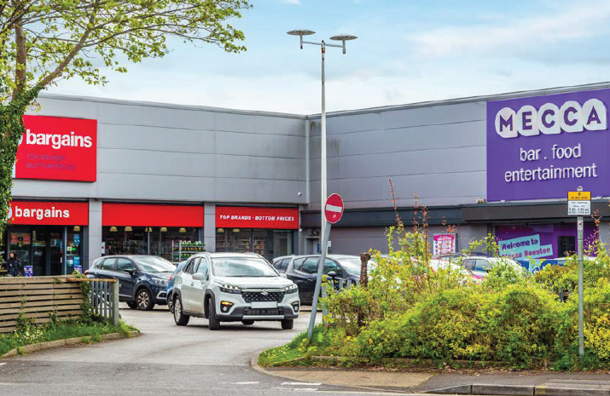
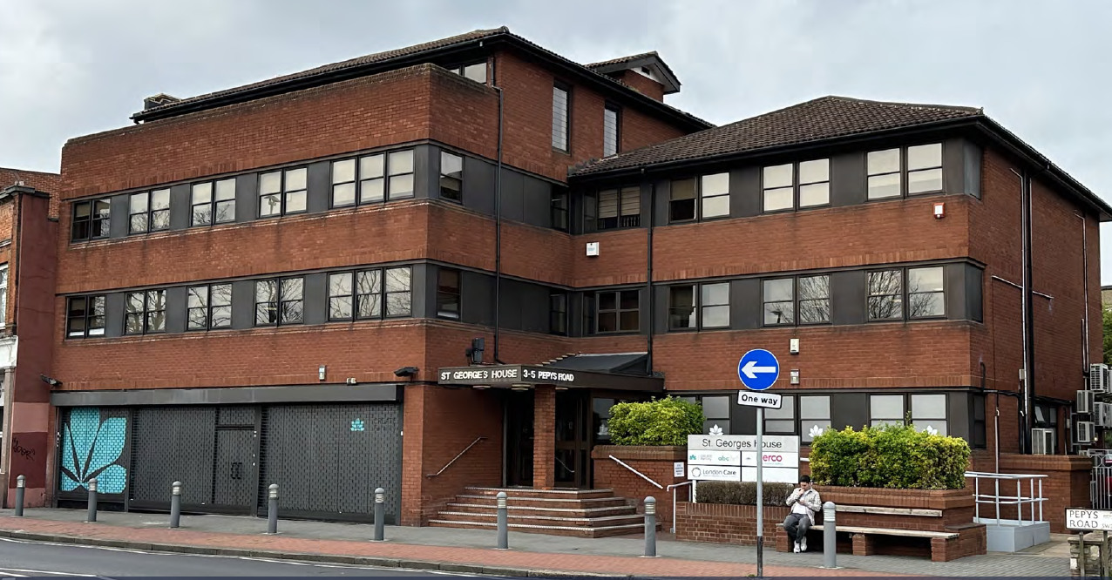
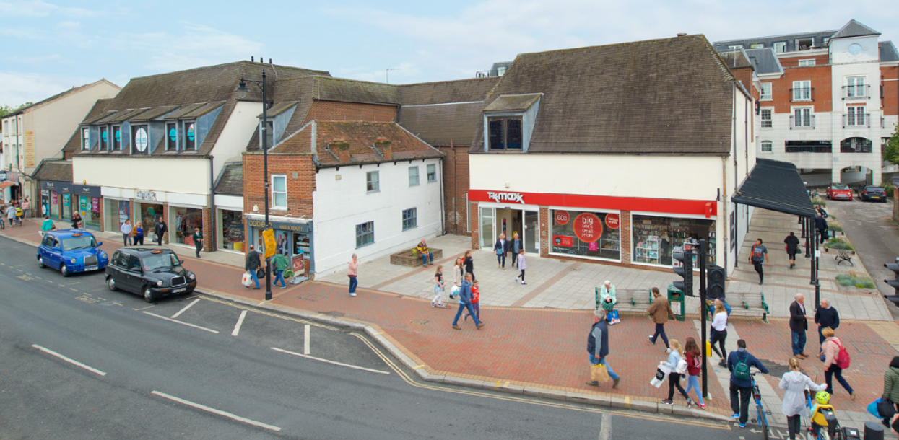
Fprop Fulcrum LP
Associates & Investments
St George’s House,
Raynes Park
Corum 1&2, Warmley, Bristol
The Pinnacle, Crawley
Beeston, Nottingham
Fprop Fulcrum LP
4 properties as of 31 March 2025
NB: Post year end – in May 2025 a property in Epsom
was purchased.
Book value of Group’s 1.3% share: £143,000
Market value of Group’s 1.3% share: £143,000
Contribution to PBT from Group’s 1.3% share: £Nil
102-120 High Street, Epsom
56

Slide 57
Appendix
57

Slide 58
Appendix
Investment Approach
Sustainable income is a priority:
The yield at purchase of any property investment must ALWAYS exceed debt service costs;
We assess investments with an emphasis on ROE as opposed to IRR (because IRR’s require an exit price assumption);
Over the long term it is income and not capital value movements which largely determine total returns;
Sustainable high-income streams can sustain leverage and thereby enable total equity returns to be boosted;
Capital is better protected if investments yield a high income, preferably from a low (reversionary) rent level.
We target higher yielding properties with sustainable income streams, enabling us to boost returns by applying leverage.
58

Slide 59
Appendix
Investment Approach (cont.)
Property is illiquid – but this illiquidity can be mitigated by rental income – liquidity through income;
Flexibility in the light of market changes;
An active approach to asset management (where possible):
2005: largely exited the UK commercial property market in 2005, re-entered in 2009;
2008: reversed asset management policy of waiting until lease expiry to renew leases following onset of the credit crunch in 2008;
2013: recommenced development activity in the UK in response to the introduction of Permitted Development Rights (PDR) and the boosting of demand for residential property with the “Help to Buy” scheme – achieved IRR of 98% for clients without leverage;
2016: varied PDR strategy to invest in offices for rental growth (as opposed to for development) due to PDR resulting in diminishing office supply / rising rents;
2020: entered the COVID-19 induced crisis with significant cash (c£23.6 million), following sale of CH8, Warsaw;
2022: Substantial reduction in net debt down to £23.5 million, and down to £19.5m by 2025.
59

Slide 60
Appendix
Shareholders > 3% as at 13 May 2025
 | % held (of issued and fully paid)
Peter Gyllenhammar AB / Galjaden Invest AB / Bronsstädet AB / Galjaden Holding AB / Browallia Asset Management Ltd / Silversläggan Invest AB | 28.05%
Ben Habib (Chief Executive Officer) | 16.38%
Alasdair Locke (Non-Executive Chairman) | 9.96%
Whitehall Associated S.A. | 7.00%
Bjorn Saven | 4.18%
Total | 65.57%
60

Slide 61
Appendix
Share Statistics as at 18 June 2025
LSE (AIM) Symbol |  | FPO.L
Share price |  | 13p
Market Cap |  | £19.2 million
Dividends |  | FY 2025 | FY 2024
 | Interim | - | -
 | Final | - | -
 | Total for year | - | -
EPS (basic) |  | 1.65p | (4.13p)
EPS (diluted) |  | 1.64p | (4.04p)
Issued & Fully Paid | 153,561,892
Issued (excl Treasury) | 147,843,109
Shares held in Treasury | 5,718,783
Outstanding share options over Ordinary shares | 12,560,000
Average strike price of outstanding share options | 22.13p
61

Slide 62
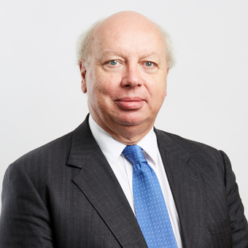
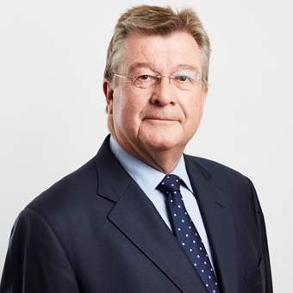
Appendix
Plc Management Team
Non-Executive Chairman — Alasdair Locke, MA (Oxon)
Alasdair began his career in banking. In 1982 he established a Singapore-based business providing finance for and investing in shipping and offshore oil service companies which was subsequently acquired by Henry Ansbacher & Co Ltd.
On his return to the UK he established Abbot Group plc in 1990, which he took public in 1995. Upon its sale to private equity in 2008 Abbot Group was one of the leading oil drilling, engineering and contracting businesses in the world, with approximately 8,000 employees in over 20 countries and an annual turnover of cUS$1.8 billion.
Alasdair maintains a wide portfolio of business interests including insurance, retailing and petroleum. He was designated Scotland Overall and Master Entrepreneur Of The Year in 1999 and received the International Business Achievement Award from the Scottish Business Achievement Award Trust in 2007.
Independent Non-Executive Director — Peter Moon, BSc (Econ)
Peter retired as Chief Investment Officer of Universities Superannuation Scheme (USS) in 2009 following a career steeped in the UK investment management industry. Aside from his 17 year tenure at USS, he was a member of the National Association of Pension Funds (NAPF) Investment Committee from 1990-1995, and adviser to Lincolnshire County Council, Middlesbrough Borough Council and the London Pension Authority. Earlier roles included Chief Investment Officer with British Airways Pensions and investment management positions at National Provident Institution, Slater Walker and the Central Board of Finance of the Church of England.
Peter is also non-executive chairman of Bell Potter (UK) Limited and a non-executive director of JPMorgan Asia Growth & Income plc. He is a former non-executive director of MBNA Europe and former non-executive chairman of Arden Partners plc and Scottish American Investment Company plc.
62

Slide 63


Appendix
Plc Management Team
Group Chief Executive & FPAM Chief Investment Officer — Ben Habib, MA (Cantab)
Ben founded and is CEO of First Property Group plc, an award winning commercial property fund manager with operations in the United Kingdom and Central Europe.
Prior to setting up First Property, Ben was Managing Director of a private property development company, JKL Property Ltd, from 1994 - 2000. He started his career in corporate finance in 1987 at Shearson Lehman Brothers. He moved in 1989 to PWS Holdings plc, a FTSE 350 Lloyds reinsurance broker, to be its Finance Director.
He was educated at Rugby School and Cambridge University.
Group Financial Director— Laura James, BA (Hons), ACA
Laura joined Fprop in 2014 following five years at Moore Stephens LLP where she qualified as a Chartered Accountant in 2011. She has successfully overseen the installation and upgrade of the Group’s integrated consolidation and accounting system.
Laura graduated from the University of Kent with a joint honours degree in Economics and Business.
63

Slide 64













Appendix
Awards
FPAM funds rank No.1 vs MSCI’s Central & Eastern European (CEE) Benchmark for the twelve years from the commencement of its operations in Poland in 2005, and for the periods from 2005 to 31 December 2008, and to the end of each of the years thereafter. In addition, FPAM’s UK Pension Property Portfolio (UK PPP) was awarded best “Small Specialist Fund” by MSCI/IPF at its UK Property Investment Awards 2017. FPAM was also one of ten fund managers, out of a pool of 95, to be awarded a Data Quality Award by MSCI.
Shortlisted:

Slide 65
Disclaimer
Certain statements made in this presentation may not be based on historical information or facts and may be "forward-looking" statements, including those relating to the Company's general business plans and strategy, its future financial condition and growth prospects, and future developments in its industry and its competitive and regulatory environment. Actual results may differ materially from these forward-looking statements due to a number of factors, including future changes or developments in the Company's business, its competitive environment, information technology and political, economic, legal and social conditions affecting the Company. These forward looking statements speak only as of the date of the Presentation Materials and accordingly you should not place undue reliance on such statements. Nothing in this presentation should be construed as a profit forecast. The information, statements and opinions contained in this presentation do not constitute a public offer under any applicable legislation or an offer to sell or solicitation of any offer to buy any securities or financial instruments or any advice or recommendation with respect to such securities or other financial instruments.
65

